Slide 1

The Netherlands NATFAL committee
NETHERLANDS
NATFAL
COMMITTEE

Slide 2

ANNEX 9: FACILITATION
What was it about?
Prevent unnecessary delays / Efficiënt processes
Passengers and Cargo
Security and Mobility
Nationals and non-nationals
Standardisatie / Innovation / implementatie

Slide 3

ANNEX 9: FACILITATION
Why?
Cost reduction
Being well connected
Notes:
Cost reduction overall also in auditing and processes
Being well connected. (example: Netherlands is a small country, with a small home market. But is very well connected.
Tourism and economic incentive
Good netwerk
Small home market.

Slide 4

ANNEX 9: FACILITATION
How?
national air transport facilitation committee (std. 8.20)
national air transport facilitation programme (Std. 8.18)
Notes:
ICAO has idea’s on how to implement these things.

Slide 5
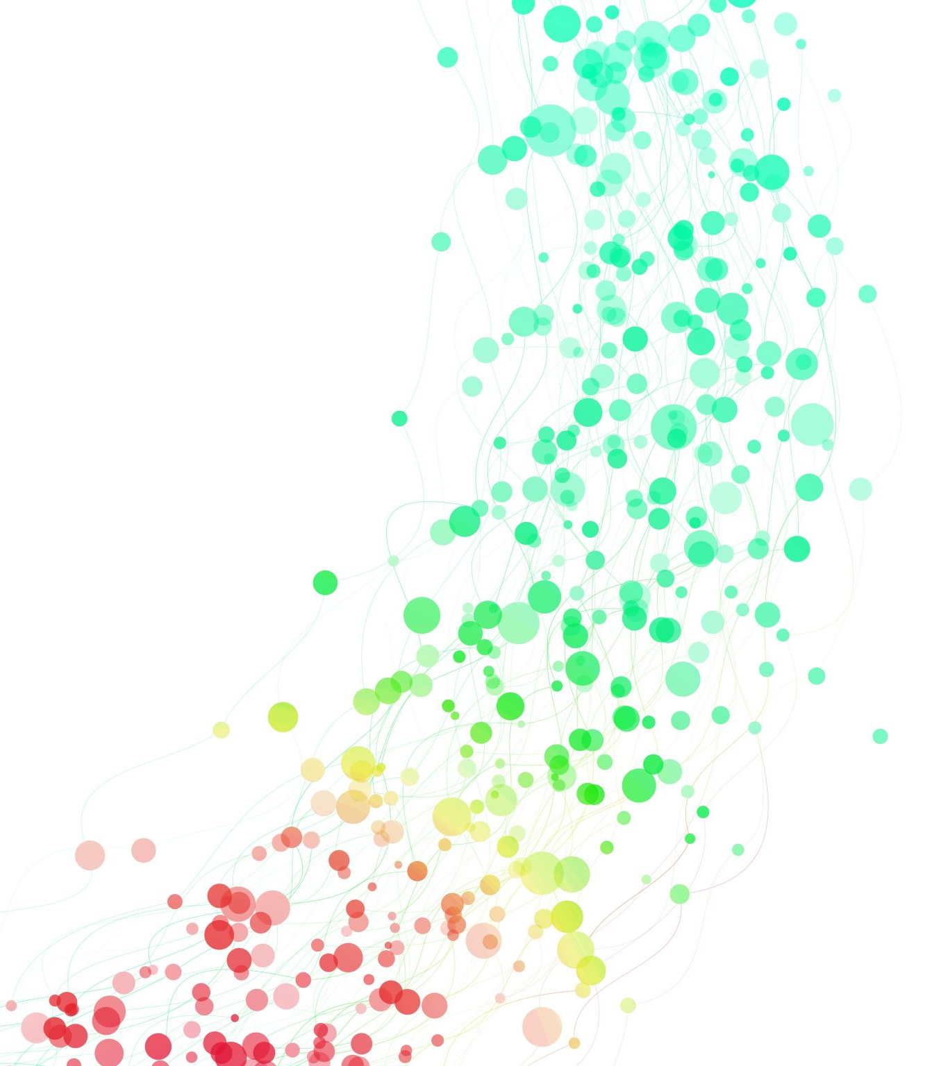
Old style NATFAL:
  Issue based
  Informal
  Infrequent
Notes:
Due to this approach, the grip on

Slide 6

Topics
Passengers:
  Nationals: Issuance of traveldocuments:
        Passports, DTC, Health
  Non-nationals:
      Issuance of traveldocuments:
        Visa’s, Residence permit
      Acceptance of documents
      Procedures
        Check in, bagagedrop, boarding,
        Passenger information (API PNR van locale landen)
        Border (security, human trafficking)
  PRM
  Public safety
Cargo:
  Documentation, Containers

Slide 7
Min.
Interior
Min.
Interior
Min.
Health
Topics
Passengers:
  Nationals: Issuance of traveldocuments:
        Passports, DTC, Health
  Non-nationals:
      Issuance of traveldocuments:
        Visa’s, Residence permit
      Acceptance of documents
      Procedures
        Check in, bagagedrop, boarding,
        Passenger information (API PNR van locale landen)
        Border (security, human trafficking)
  PRM
  Public safety
Cargo:
  Documentation, Containers
Min.
Foreign
affairs
Min.
Justice
Min.
Foreign
affairs
private
Min.
Justice/
defence
Min.
Justice/
private
Private
Min. Infra
Munici-
pality
Min. Fin

Slide 8

CHALLENGES
Diverse topics
Multiple stakeholders
  Both public and private
  Other departments, who have their own policy
Legislation and technology
Notes:
Attention span
Lack of knowledge

Slide 9
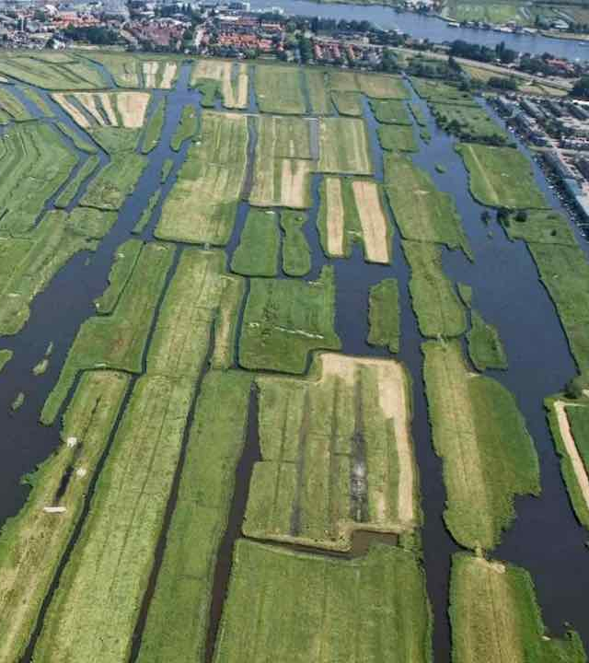
Poldermodel
A model for Consensus

Slide 10










PLATFORM
STEERINGGROUP
EXPERTGROUP
EXPERTGROUP
Entry Measures
EXPERTGROUP
Health
Notes:
Solutions/lessons learned:
-Expertgroups to focus topics. And make sure they are interesting for all participant
-Legal entity
-Levels in seniority to be able to have talks on a higher level and find compromise where lower levels cannot
-Frequency and the programme to pull the parties in to the challenges posed by travel and international

