Slide 1
INTERPOL Commitment in Developing Interoperable Border Solutions
Fabrizio di Carlo
INTERPOL Specialized Officer
SESSION 7
BORDER CONTROL: INSPECTION SYSTEMS AND TOOLS & INTEROPERABLE APPLICATIONS

Slide 2
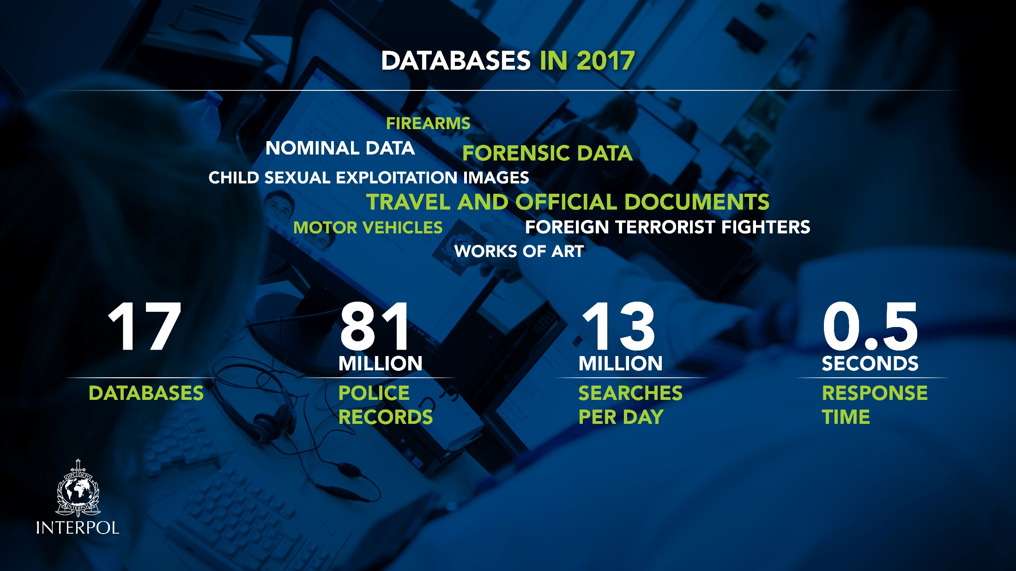

Slide 3
INTERPOL BORDERS ELEMENTS
INFORMATION
TECHNOLOGY
INFRASTRUCTURE
INTERPOL Secure Cloud I-24/7
INTEROPERABILITY/INTEGRATION WITH NATIONAL SYSTEMS
Data Contribution
Data Consultation
DATABASES
First Line Oriented Databases
Second/Third Line Databases

Slide 4
INTERPOL OPERATIONAL DATABASES
First Line Checks
Stolen and Lost Travel Documents
Nominal Databases
Travel Documents Associated with Notices
Stolen Motor Vehicles
Stolen Vessels
Illicit Arms Records and Tracing Management System
Second and Third Line Inspections
EdisonTD
Digital INTERPOL Alert Library - Document*
Document Information System of Civil Status
Fingerprints
Interpol Ballistic Information Network
DNA
Facial Recognition

Slide 5
Interoperability among INTERPOL databases
The INTERPOL’s internal goal is to have our border-oriented databases addressing operational demands (speedy passenger control) by leveraging fully interoperable databases (single query access to all data) supported by modern technology.

Slide 6
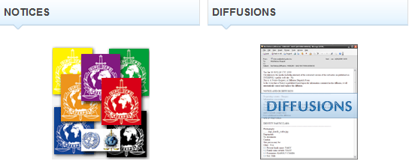
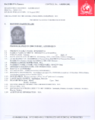
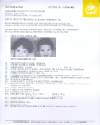
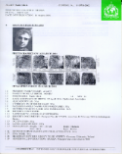
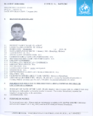
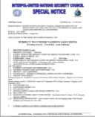
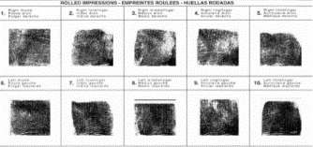
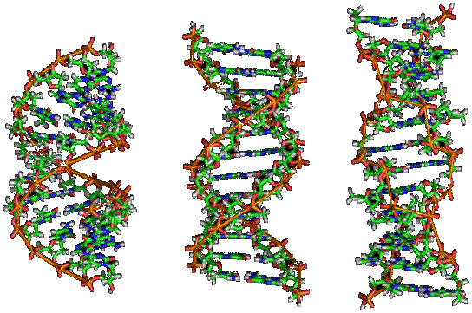
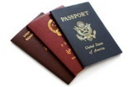
Presentation title
NOMINAL database
… now populated via INTERPOL I-Link Web Services and accessible via FIND
TDAWN
AFIS
DNA

Slide 7
Interoperability with national/regional systems
The INTERPOL’s external goal is to have our border-oriented databases interoperable with existing national systems thus ensuring data consistency (national and INTERPOL databases timely synchronized) and query effectiveness (queries performed through national applications are simultaneously performed against INTERPOL databases)

Slide 8



INTERPOL web services for data contribution
NCB Local Network
I-24/7
WISDM/I-Link
Interface
National Database
National Network
WISDM/I-Link Bridge
»
Through a bridge connected to the web services interface of WISDM/I-Link

Slide 9
Advantages
Web services provide the following benefits:
Interoperability between information systems
Automation of work processes
Avoid duplication of data input (gain time and human resources)
Enhancement of the quality of information (reducing risk of human error)

Slide 10
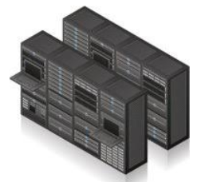

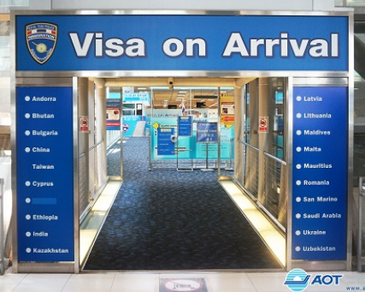


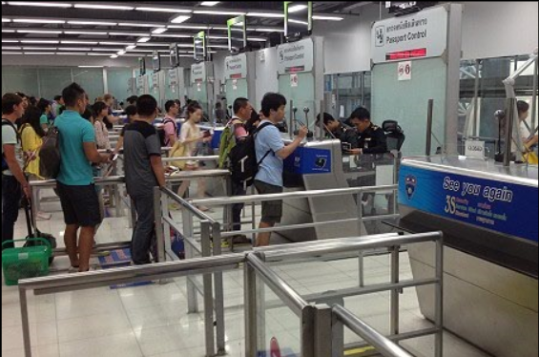
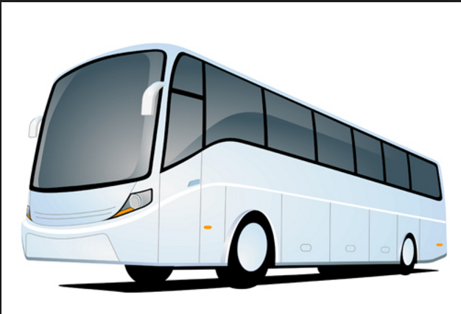



INTERPOL web services for data contribution
Trusted Zone
Untrusted
Zone
Advanced Passenger Processing (API/PNR)
Trusted
Zone
E-Visa, Visa or Visa Upon Arrival System
DMZ Zone
Border Control or Immigration Client
Border or Immigration Server Farm
FIND
INTERPOL Secure Cloud

Slide 11
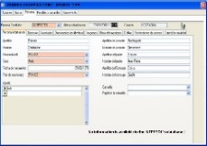
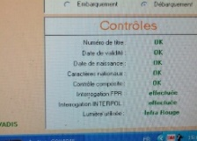

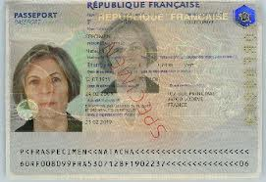
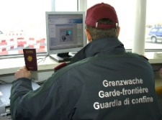
Presentation title
Advantages
Ready to integrate solution to access INTERPOL’s database
Solution allows officers to submit MULTIPLE queries simultaneously and get ONE consolidated answer
Top-level security is ensured using INTERPOL’s I-24/7 communications system
Response to the query is immediate (< 1 sec)
System notifies immediately member countries concerned of potential hit
National SOPs adapted to each country
Ready to integrate solution into existing systems
  No changes in the daily work of front-line officers
  No special training required
  No language barriers [usage of national language(s)]
  Easily adapted to individual country requirements and capabilities
  Fully interoperability with i-API and eVisa
Mexico
France
Switzerland

Slide 12
…and in the pipeline….
A new approach for travel document control
FIELDS Project
“Access to supporting materials related to fraudulent travel document during passenger screenings”
Availability of Frontex/QCC
Through
INTERPOL/Dial-Doc integration to the national border application

Slide 13
Information
Management
Interoperability
Connectivity
I24/7
QCC

Slide 14
Contact Details
Name: Fabrizio Di Carlo
Email: f.dicarlo@interpol.int

