Slide 1

Strengthening Interoperable Borders: IOM’s Technical Assistance in Implementing Passenger Data Systems (API/PNR)
15th ICAO TRIP Symposium and Exhibition
25-28 June 2019
Erik Slavenas
Identity Management and Biometrics Officer, IBM Division, IOM Geneva
eslavenas@iom.int

Slide 2

IOM at a glance
The UN Migration Agency
Focus on project and programme implementation
Solid capacity to implement large-scale technical assistance projects round the world
Scale of programming: 2,277 projects with total operational expenditure USD 1,552 Million (2018)
Worldwide presence:
  offices in over 150 States and 393 field locations
  almost 11,000 IOM staff
Demonstrated ability to deliver results in developing, fragile and security-phased countries
IOM’s border management assistance portfolio: total current budget USD 220 Million and 205 projects

Slide 3
Why IOM works on API/PNR
API/PNR are integral part of IOM border control management technical assistance
Vendor-driven environment: demonstrated need for IOM and other int’l organisations to act as an independent, impartial ‘honest broker’ in assisting Member States to identify their needs and sustainable good-value solutions
IOM’s capacity to manage procurement tenders and implement complex infrastructure projects that go beyond advocacy, training, workshops and technical consultations
API/PNR are an inherent component of cooperation frameworks IOM already has in place with other key API/PNR players (WCO, IATA, ICAO and others)
API is a focus area in the IOM Action Plan for ICAO TRIP Implementation Assistance for the 2018-2020 triennium
Shortage of user-friendly, comprehensive guidance material for API/PNR implementation
Ability to fundraise: trust and ongoing working dialogue between IOM and donor programmes
Visibility, new programming opportunities, relevance to IOM’s mandate and strategic objectives

Slide 4
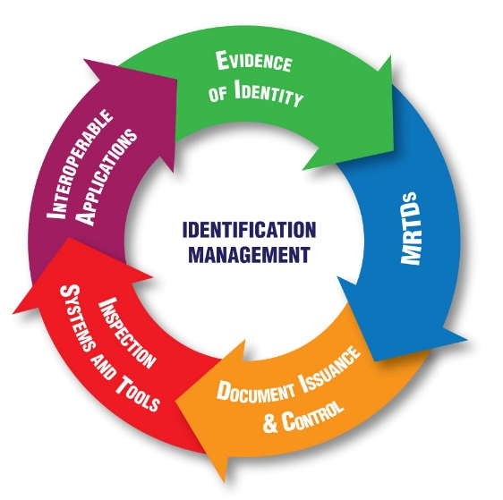
IOM Support to ICAO TRIP Strategy Implementation
IOM-ICAO MoU in November 2016
Focus on technical assistance projects in supporting States in ICAO TRIP Strategy implementation
IOM Action Plan for ICAO TRIP Implementation Assistance for the 2018-2020 triennium
A major focus area: passenger data (API and PNR) implementation assistance

Slide 5
Why API/PNR matters to Member States
Political momentum: UN SC Resolutions, especially 2396 (2017) and 2178 (2014)
International regulatory framework: ICAO Standards and Recommended Practices in Annex 9 – Facilitation
Good governance of borders: States increasingly see value of API/PNR and risk management to strengthen both border security and facilitation

Slide 6


Current IOM projects
Western Balkans - Albania, Bosnia and Herzegovina, the former Yugoslav Republic of Macedonia, Montenegro and Serbia: legal and IT assessments, regional technical consultations; validation workshops on assessment results, forming and facilitating national API working groups – close cooperation with OSCE
Ukraine: technical consultations, developing APIS procurement, improving API data analytics
Georgia: API legislation, API working group, technical consultations, workshops, RFI and tender management, analytics
Armenia, Azerbaijan, Turkey: API/PNR training for government authorities
Turkmenistan: API/PNR legal assessment; API training co-funded and coorganized with OSCE. A new regional project in Central Asia
Trainings and assessments in Djibouti and Rwanda. Ongoing consultations with other African Union Member States
Donors

Slide 7









Close cooperation and coordination with partners

Slide 8
Main areas of API/PNR assistance
AWARENESS RAISING
TECHNICAL ASSESSMENT
LEGAL ASSESSMENT
STAKEHOLDER LIAISON
PROCUREMENT TENDER

Slide 9
Typical API/PNR implementation steps
Generally, it is advisable to implement API first (iAPI and PNR much more complex and costly)
Awareness raising (policy, functions, technical principles, legal implications etc)
API/PNR needs assessment (policy, legal and institutional frameworks, IT architecture and information management, equipment and infrastructure)
Creation of a national API and/or PNR Committee / Working Group to drive the process and ensure compliance with international standards (best if airlines are invited from the start)
Inter-agency consultations on roles and responsibilities of relevant actors at the national level (determination of leadership). Deciding Single Window facility arrangements.
Amendment of the legal framework and/or development of new legislation (no airline will provide API/PNR data without a proper law in place), which specifies:
  which API/PNR data can be collected
  for what purposes (e.g. countering irregular migration, serious crime)
  by whom and which other “competent authorities” can have access to it (customs, intelligence services etc)
  how long it can be retained (24 hours for API, 6 months for PNR ‘unmasked’, another 4,5 years PNR ‘masked’)
  Which data protection authority
  Right for travelers to request which data have been collected on them
  Right for travelers to appeal if incorrect data has been collected
  Data protection safeguards and control

Slide 10
Typical API/PNR implementation steps (contd.)
Creation of a Passenger Information Unit (EU terminology and setup)
  Receives and processes API/PNR data
  Can be based in border guard, criminal police, police international cooperation unit, police counter-terrorism unit etc
  Acts as a guardian of API/PNR data
  Shares API/PNR data upon specific requests from other governmental agencies authorized by law to receive API/PNR data
Tender for service providers and hardware/software (will vary heavily depending on the local set up)
Development of relevant IT solutions
Testing and roll-out (ensuring connections to airline reservation systems, interoperability with other systems at the national level)
Hiring, training and retraining of staff of the Passenger Information Unit and other governmental agencies receiving API/PNR data
And last but not least – to develop analytics and risk management capabilities to make use of API/PNR to enhance border security and facilitation!

Slide 11
Challenges and
lessons learned
Knowledge of API/PNR in countries is often quite limited, even after repeated awareness raising and technical workshops
Lack of capacities at the national level (conceptual, IT, data analytics)
Misconceptions about API/PNR, need to be dispelled. Misconceptions can cause more difficulties than lack of knowledge
Inter-agency cooperation: key to success and a major challenge. Especially, in reaching consensus about a lead agency and Single Window. Tensions and lack of trust between stakeholders quite common – and may need time and effort to build a working relationship
Sustainability of API.PNR technical assistance: a major challenge is monthly data service fees if a private sector service provider is used. More an issue to airlines than government agencies but still important to ensure continuity and sustainability of API/PNR systems. The systems will be sustainable only if service fees are budgeted and paid as per contract.

Slide 12
• The foundation of success in API/PNR implementation is a solid needs assessment – and reaching consensus between stakeholders about the way forward – and articulating it into a written implementation plan. A common mistake is to jump straight into a procurement tender or any particular service and product without articulating needs and doing extensive consultations.
• Lack of effective privacy and data protection at the national level. Privacy and data protection is primarily about legislation – but not only. Also includes managing the media, public opinion, human rights NGOs, having a mechanism to address grievances by the public, etc
Challenges and
lessons learned (contd.)

Slide 13
• API/PNR implementation remains primarily a vendor-driven environment. Vendors are motivated by profits and may be tempted to offer unnecessary, excessive, incompatible or overpriced products or services. It helps a lot if you can rely on a ‘honest broker’ – an impartial int’l organization, consultancy or technical expert - in assisting a State in identifying their needs, ensuring compliance with international specifications and procuring sustainable good-value solutions.
• Lack of available national budget and dependence on donor funding or free systems that may come with strings attached
Challenges and
lessons learned (contd.)

Slide 14
Challenges and
lessons learned (contd.)
• Data quality is a recurring theme in the usefulness of API/PNR systems. Garbage in, garbage out.
• An important part of an API/PNR procurement tender is having an exit strategy when using data services. Ignoring this can lead to instances where users are locked into a contractual relationship with a service provider and unable to switch to another vendor that offers a better or more relevant service.
• A good working relationship with carriers is vital. It does not happen on its own and requires investment and effort: having dedicated airline liaison officers, structured communication channels, regular meetings. Poor relations between national government agencies and air carriers can serial an otherwise successful API/PNR implementation.

Slide 15
For API/PNR assistance pls contact the closest IOM regional focal point
COLUCCI Donato, IOM Bangkok docolucci@iom.int
PRUTSCH Franz, IOM Cairo FPRUTSCH@iom.int
RAMKISHUN Marcellino, IOM Nairobi mramkishun@iom.int
SOURI Vijaya, IOM Dakar vsouri@iom.int
STYP-REKOWSKA Livia, IOM Vienna lstyprekowska@iom.int
WARN Elizabeth, IOM Pretoria ewarn@iom.int
WINTER Cy, IOM San Jose CWINTER@IOM.INT
LILLEORG Kristiina, IOM Brussels klilleorg@iom.int
Please cc: IBM Division at IOM HQ ibm@iom.int

