Slide 1
GTE/17 IP/6
RVSM Safety Analyses for Mexico Airspace
CALENDAR YEAR 2016

Slide 2
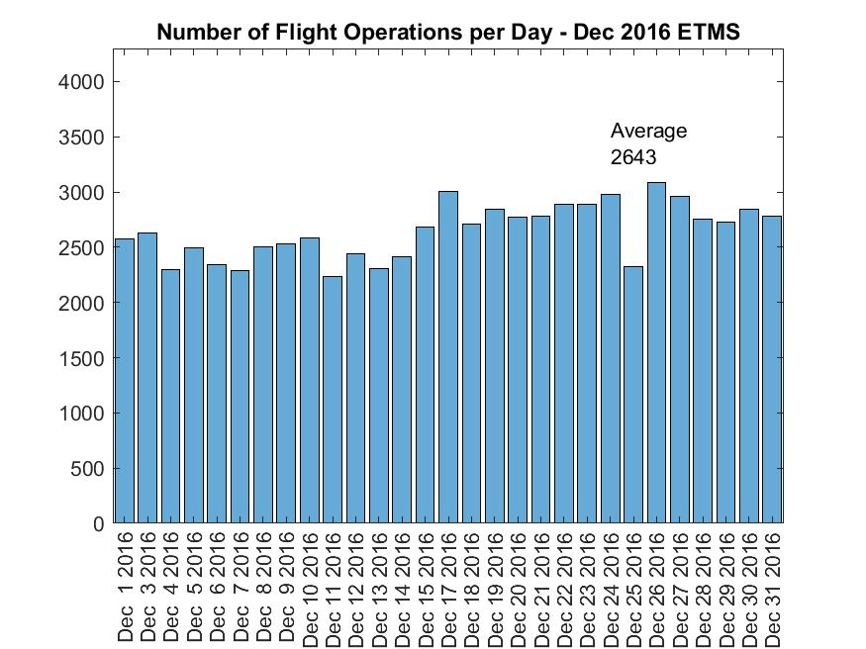
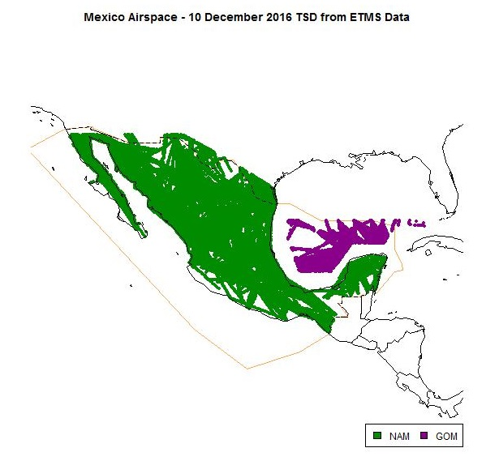
TFMS Data – December 2016

Slide 3
Summary of Mexico Reported LHD Events - 2016
LHD Code | LHD Description | No. of LHD Events | LHD Duration (Min) | No. of FLs Crossed Without Clearance
E | Coordination errors in the ATC-unit-to-ATC-unit transfer of control responsibility as a result of human factors issues | 15 | 14 | 0
H | Airborne equipment failure leading to unintentional or undetected change of flight level (e.g. altimetry errors) | 2 | 3 | 1
M | Other | 15 | 0 | 0
 | Totals | 32 | 17 | 1

Slide 4
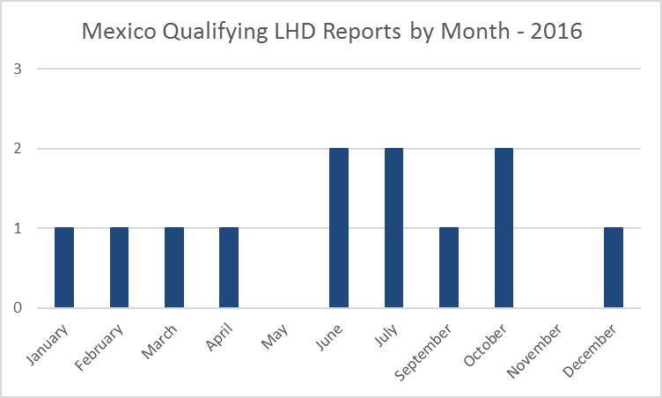

Slide 5
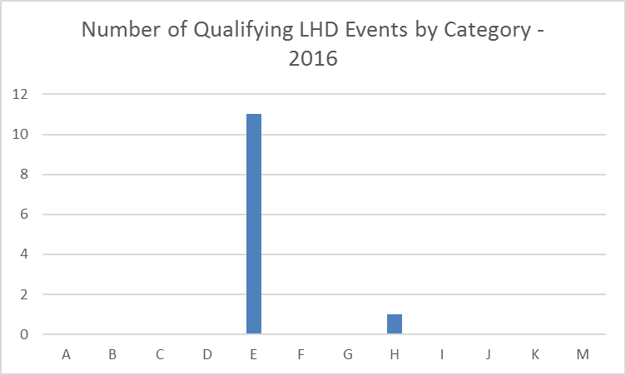

Slide 6
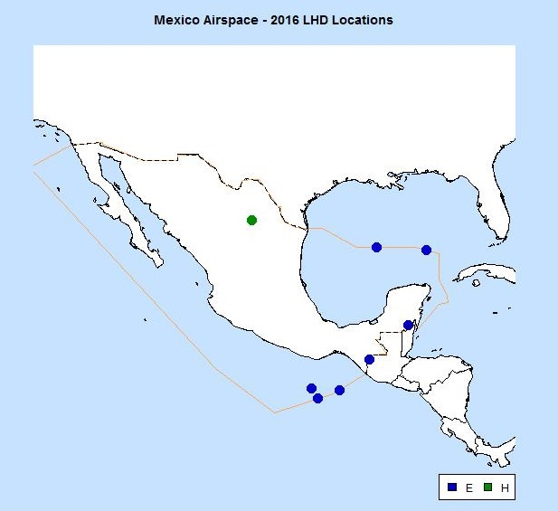

Slide 7
Vertical Risk Estimates
 | Vertical Risk Estimate (x 10⁻⁹ fapfh)
Technical Risk | 0.05
Operational Risk | 4.72
- Same Direction | 0.01
- Opposite Direction | 4.42
- Crossing | 0.02
Total Vertical Risk | 4.77

