Slide 1
ECONOMIC REGULATION IN CIVIL AVIATION
Agencia Federal de Aviación Civil
MÉXICO

Slide 2

ECONOMIC REGULATION OF AIRLINES
Airlines have fare freedom.
The AFAC supervises the financial capacity compliance of airlines. The goal is to ensure they can provide service with safety, quality, and continuity.
If suspicious or risky behavior is detected in an airline's financial situation, two actions can be taken: investigating the market competition status and/or taking regulatory precautions.
If lack of competition is detected, AFAC asks for the antitrust authority validation, and imposes price caps for specific frequencies, routes or whole airlines.

Slide 3
ECONOMIC REGULATION OF AIRPORTS
Type | Airports | Regulation
Treasury (19) | Army (11) Navy (6) MEX NLU | The Treasury authorizes airport fees.
Almost no regulation (10) | CZA, CVJ, LZC, PQM, PPE, QRO, TPQ, TLC, TGZ, TQO | Each airport sets the fees to be charged.
Annual price cap per traffic unit (34) | ASUR (9) GAP (12) OMA (13) | AFAC determines the five-year annual price cap per traffic unit (TMC) for each airport.

Slide 4
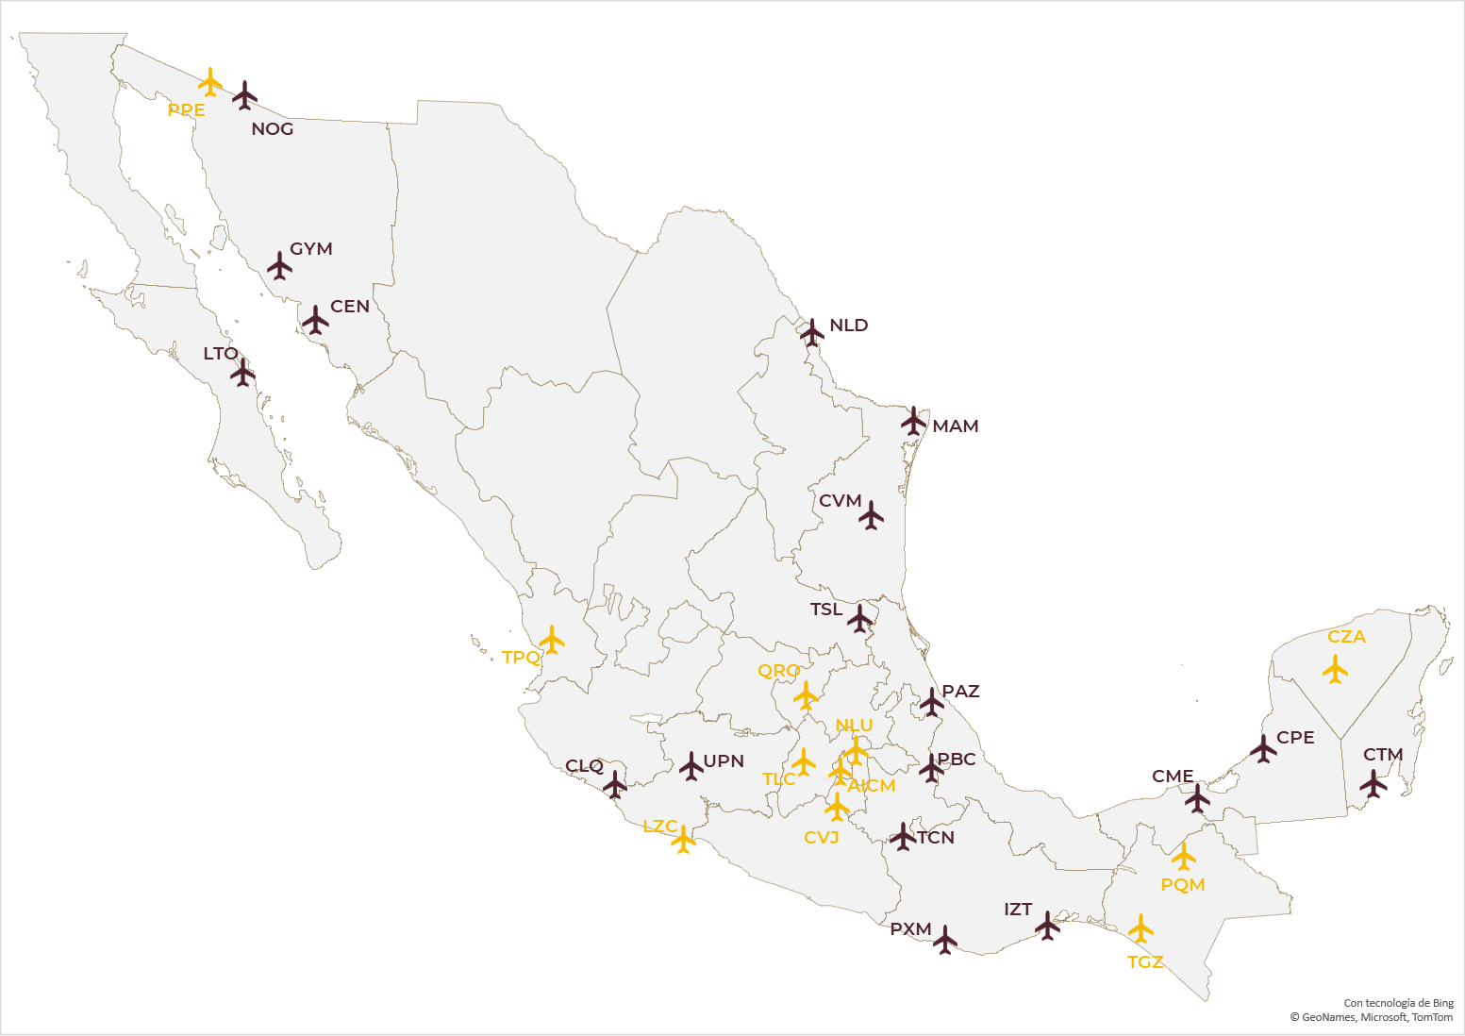



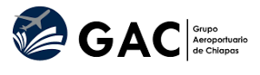


PUBLIC INVESTMENT AIRPORTS

Slide 5
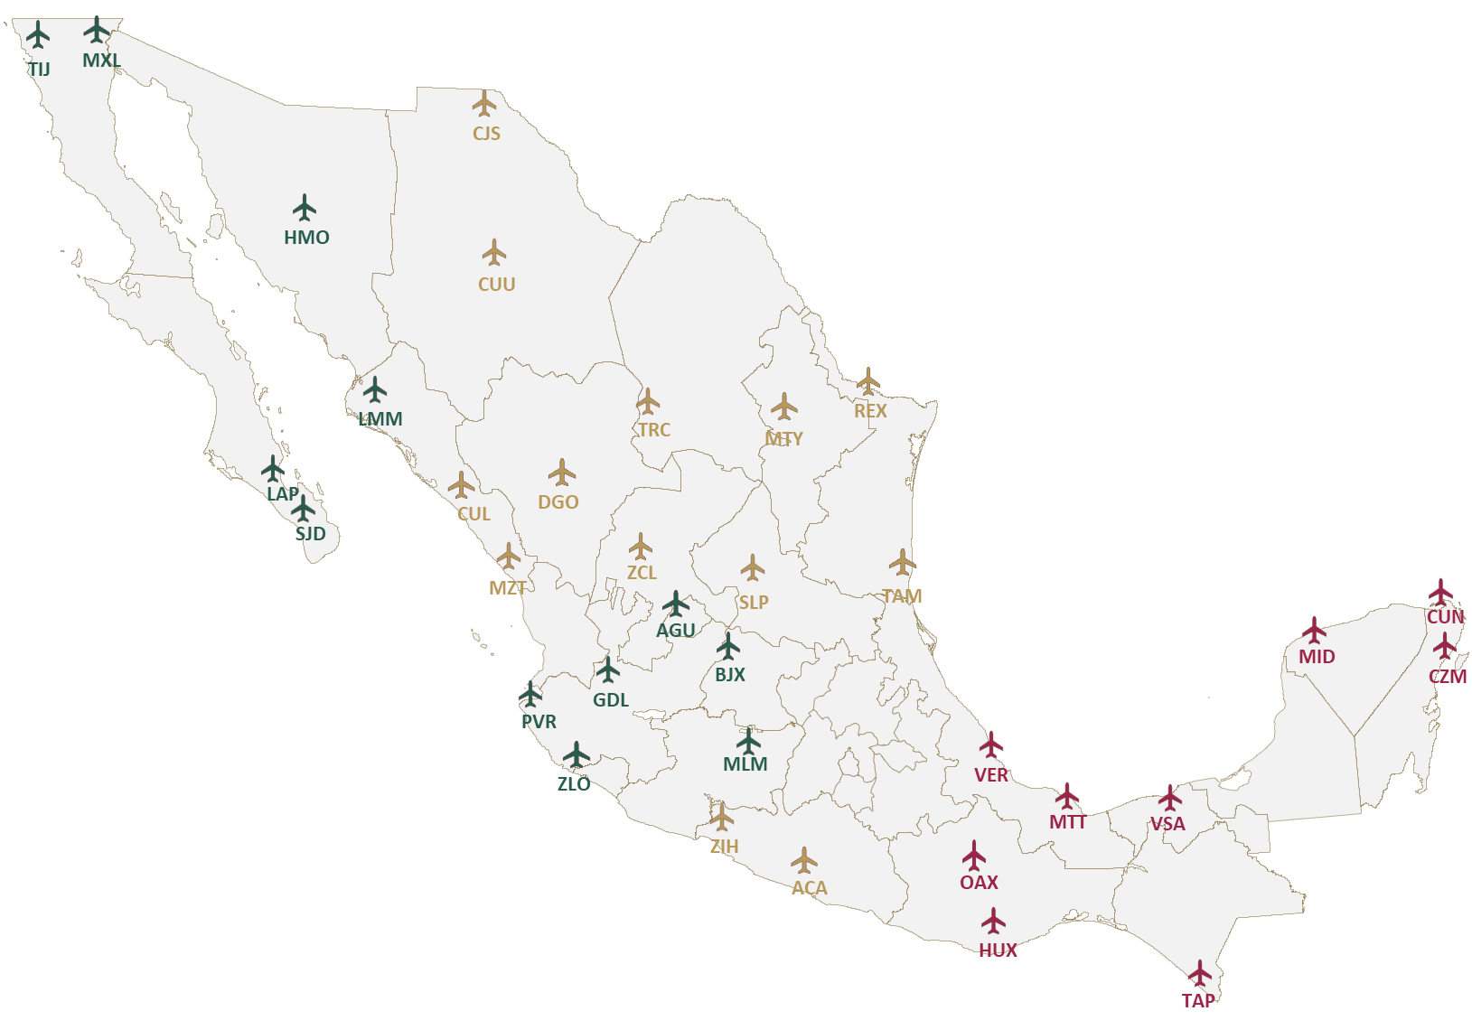


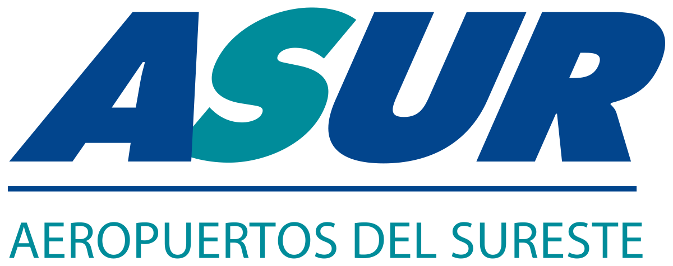
PRIVATE INVESTMENT AIRPORTS

Slide 6
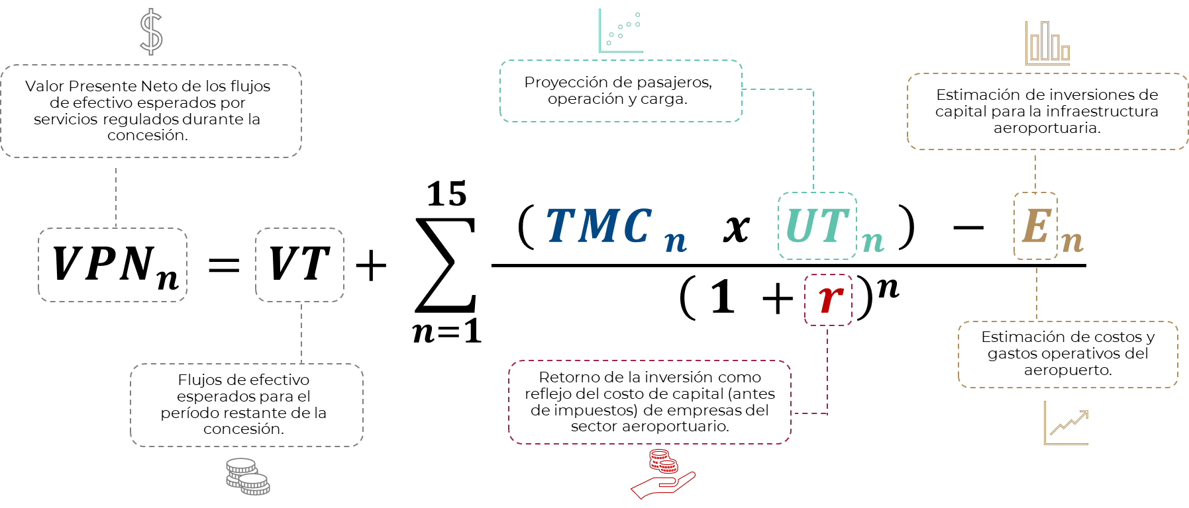
PRICE CAP PER TRAFFIC UNIT (TMC)

Slide 7
TMC CAGR VS GENERAL AND AIR TRANSPORT INFLATION

Slide 8
INFRASTRUCTURE INVESTMENT PER TRAFFIC UNIT

Slide 9
INCOME, COST, AND OPERATING PROFIT PER TRAFFIC UNIT

Slide 10
FIRST RESULTS ON THE CHANGE OF REGULATIONS
AIRPORT | NEW TMC 2024 – 2028 | CHANGE (%) | CHANGE IN INVESTMENTS (%)
CUN | $ 335.09 | 28.6% | 257.4%
CZM | $ 429.80 | -19.0% | 111.0%
HUX | $ 460.39 | 66.7% | 30.9%
MID | $ 285.51 | -3.3% | -22.2%
MTT | $ 506.40 | -6.5% | 49.4%
OAX | $ 337.83 | 35.1% | 307.5%
TAP | $ 278.85 | -24.8% | -61.3%
VER | $ 268.43 | -12.3% | -18.0%
VSA | $ 301.71 | 2.1% | 12.0%

Slide 11
GRACIAS

