Slide 1
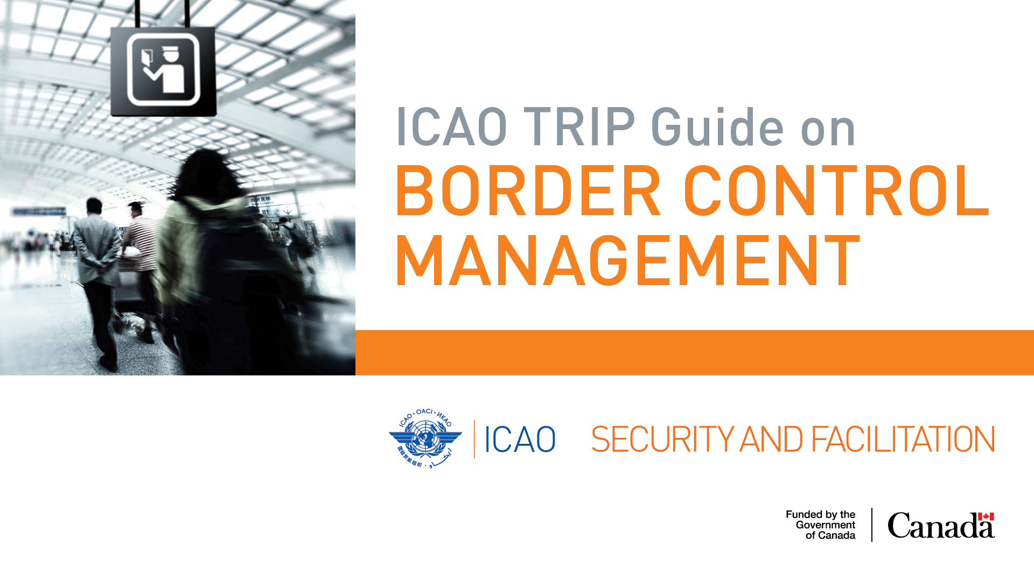
MAY 2018
Notes:
The purpose of this presentation is to provide an overview of the ICAO Traveller Identification Programme (TRIP) Guide on Border Control Management (BCM).
The ICAO TRIP Guide was developed as part of the Canada-funded project Strengthening Border Control Management in the Caribbean Region (2016-2018).
The Guide was first published in April 2018, and the latest version is available for download from the ICAO website: https://www.icao.int/Security/FAL/TRIP/Pages/Publications.aspx

Slide 2
Structure of the Presentation
6 Elements:
Introduction (slides 2 to 7)
Guide Concepts (slides 8 to 12)
Strategy and Environment (slides 13 to 19)
TRIP Implementation – Inspection Systems and Tools, Interoperable Applications and Traveller Journey (slides 20 to 40)
TRIP Implementation – Risks and Constraints (slides 41 to 47)
Conclusion – Assistance to States and ICAO Contacts (slides 48 to 50)
Notes:
The substantive content of the presentation is at Section 4: An explanation of how the implementation of the two ICAO TRIP elements most concerned with BCM, Inspection Systems and Tools and Interoperable Applications, are applied across the various phases of the traveller journey.

Slide 3
i. INTRODUCTION
Scope of the Guide
Contributors
How to use the Guide
TRIP and BCM
Notes:
Element i. Introduction: 4 slides

Slide 4


Scope of the Guide
Why? Challenging global environment
  Increase in international air travel
  Constrained airport infrastructure
  Evolving security threats
Framework: Annex 9 – Facilitation, ICAO TRIP Strategy, Doc 9303, UN treaties and UN Security Council Resolutions
Area: Air travel environment, border controls applied to travellers
Application: Best practice for use of technology and beyond
Notes:
ICAO has developed the TRIP Guide on BCM in response to an increasingly challenging global civil aviation environment:
Increase in international air travel: ICAO forecasts that air traffic will increase from 3.8 billion passengers in 2016 to 7 billion passengers in 2030
Constrained airport infrastructure: Expanding and building airports is expensive
Evolving security threats: In terrorism and other transnational crime
The Guide is framed by:
ICAO Annex 9 – Facilitation (Chapters 3, 8 and 9);
ICAO Traveller Identification Programme Strategy – or TRIP Strategy. Two elements of the TRIP mainly relate to BCM. This will be discuss later in this presentation;
ICAO Doc 9303, Technical Specifications for Machine Readable Travel Documents (MRTDs); and
United Nations treaties and relevant Security Council Resolutions.
The Guide focusses on the air travel environment and on the border controls applied to travellers (the immigration perspective). It does not include other Facilitation matters such as Customs, Quarantine, Health, Aircraft.
The substantive content of the Guide focusses on the application of technology in BCM. However, this technology is put in the broader context of the specific environment and challenges faced in different States, and with a view of furthering the national interest of States (economic, social and political benefits of air travel), meeting their international obligations and ensuring that threats are understood, and risks mitigated.
The application of technology in BCM can improve:
Transactional efficiency in traveler processing – delaying or preventing the investment required in new airport infrastructure; and
Traveller identification and risk assessment – so that threats can be identified by States and interventions can be made to prevent or deter travel.
4

Slide 5
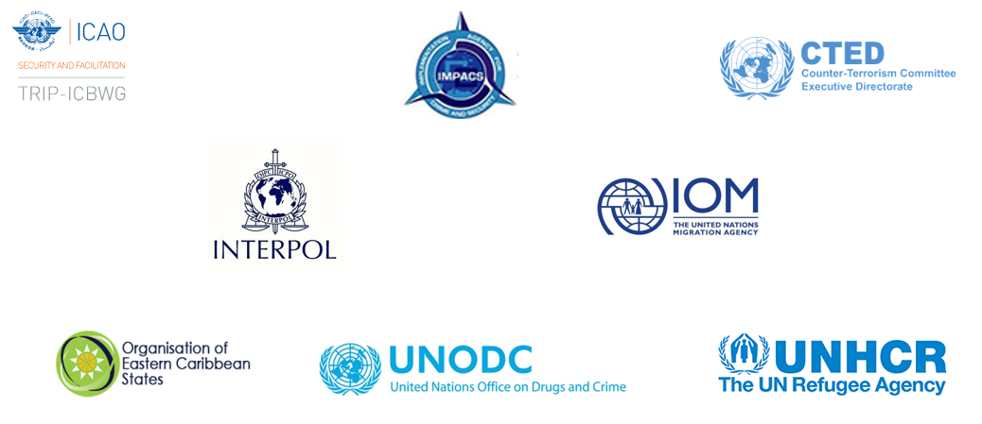
Contributors
Notes:
Nowadays, multiples actors are involved with border security and related matters, hence the extensive consultation that took place with States, international and regional organization and groups of experts for developing the Guide:
Caribbean Community (CARICOM) Joint-Regional Communication Centre (JRCC) Implementation Agency for Crime and Security (IMPACS)
FRONTEX
ICAO Implementation and Capacity Building Working Group (ICBWG)
ICAO New Technologies Working Group (NTWG)
INTERPOL
International Organization for Migration (IOM)
Organisation of Eastern Caribbean States (OECS)
United Nations High Commissioner for Refugees (UNHCR)
United Nations Office on Drugs and Crime (UNODC)
United Nations Security Council Counter-Terrorism Committee Executive Directorate (CTED)
The content of the Guide was further refined following consultation with Caribbean States at the ICAO TRIP Workshop in Border Control Management in the Caribbean Region, Jamaica, November-December 2017.
5

Slide 6
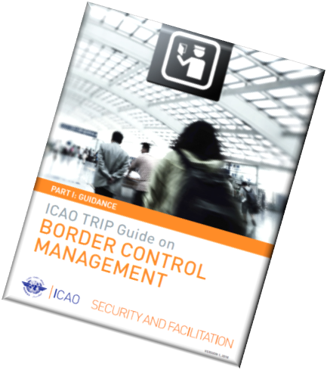
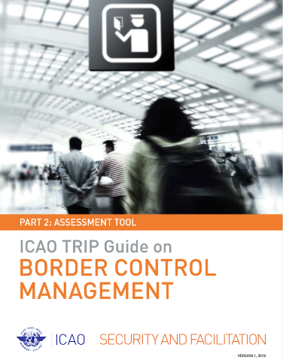
How to use the Guide
Part 1: Guidance
Part 2: Assessment Tool
Download at: https://www.icao.int/Security/FAL/TRIP (along with other TRIP publications)
Notes:
The Guide is published in two parts:
Part 1: Guidance comprises the detailed, substantive content describing best practice related to the Inspection Systems and Tools and Interoperable Applications available for national BCM, while acknowledging the specific border control challenges faced in different States. ICAO SARPs are referenced throughout the Guide when relevant to a specific topic.
The Part 1: Guidance is intended to help senior, middle and operational level management within national agencies responsible for immigration and border controls, as well as those other national agencies that rely on traveller identification data. This can include helping to inform strategy and policy development, budgetary planning, legislative reform initiatives, ICT systems change, operational planning, the identification of training needs, and the application of best practices
Part 2: Assessment Tool provides high level guidance on considerations to be taken into account when a State intends to adopt new technology and processes, optimize existing systems or develop BCM strategies and policies.
The Part 2: Assessment Tool is intended to be used by States to self-assess their BCM systems, processes and capabilities and provides a structured framework for technical experts performing a technical assistance mission.
Both the Part 1: Guidance and Part 2: Assessment Tool follow the same structure. The Part 2: Assessment Tool is the companion document of the Part 1: Guidance and should therefore be read and used in conjunction with it.
6

Slide 7
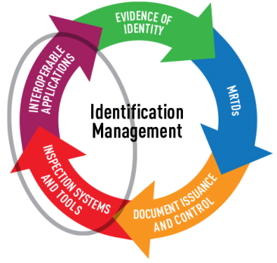
ICAO TRIP and BCM
Notes:
The TRIP Strategy employs an approach consisting of five interlinked elements that help States to establish and confirm the identity of travellers.
The five elements are complementary and mutually reinforcing.
National identification arrangements produce Evidence of Identity to support the issuance of Machine Readable Travel Documents (MRTDs). Technical specifications contained in ICAO’s Doc 9303, Machine Readable Travel Documents, along with the security of Document Issuance and Control, enhance the integrity of the travel document. Travel documents are therefore only as secure and reliable as the systems and protocols for their production and issuance, and the national identification arrangements behind them.
The fourth and the fifth are the two TRIP elements mainly related to BCM and are the focus of the ICAO TRIP Guide on BCM.
Inspection Systems and Tools enable border authorities to capture, verify and record data contained in the MRTDs and about travellers. Controls on the holders of travel documents can be performed at the different phases of the journey: pre-departure, pre-arrival, arrival, stay and departure (refer to slide 12).
Those controls are enhanced by the global sharing of data about travellers and their travel documents achieved by Interoperable Applications. The collection of traveller information completes the TRIP cycle by contributing additional evidence of identity concerning foreigners entering States.
Together, the elements of the ICAO TRIP Programme enable States to identify travellers and perform targeted traveller risk assessments.
7

Slide 8
ii. GUIDE CONCEPTS
Linking Inspection Systems and Tools and Interoperable Applications
Border Control Systems
The “Snowman” – the unifying concept of the Guide
Phases of the Traveller Journey
Notes:
Element ii. Guide Concepts: 4 slides

Slide 9
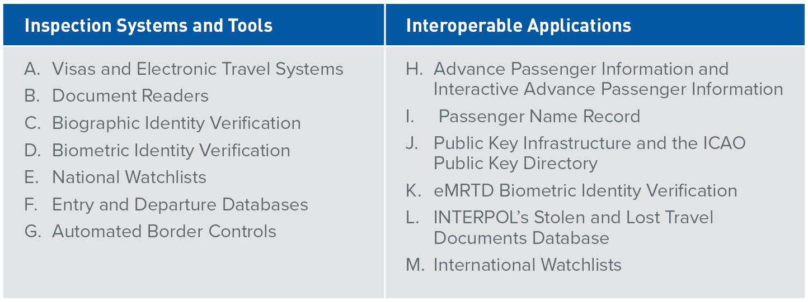
Inspection Systems and Tools and Interoperable Applications
Notes:
The substantive content of the Guide is comprised of the 13 technical topics (Sections 4 and 5 of the Guide).
Section 4. Inspections Systems and Tools comprises seven technical topics describing how States can capture, verify, match and record the data contained in MRTDs and about travellers:
A. Visas and Electronic Travel Systems
B. Document Readers
C. Biographic Identity Verification
D. Biometric Identity Verification
E. National Watchlists
F. Entry and Departure Databases
G. Automated Border Controls
Section 5. Interoperable Applications comprises six technical topics describing how States can access and share data about travellers and their travel documents:
H. Advance Passenger Information and Interactive Advance Passenger Information
I. Passenger Name Record
J. Public Key Infrastructure and the ICAO Public Key Directory
K. eMRTD Biometric Identity Verification
L. INTERPOL’s Stolen and Lost Travel Documents Database
M. International Watchlists
9

Slide 10
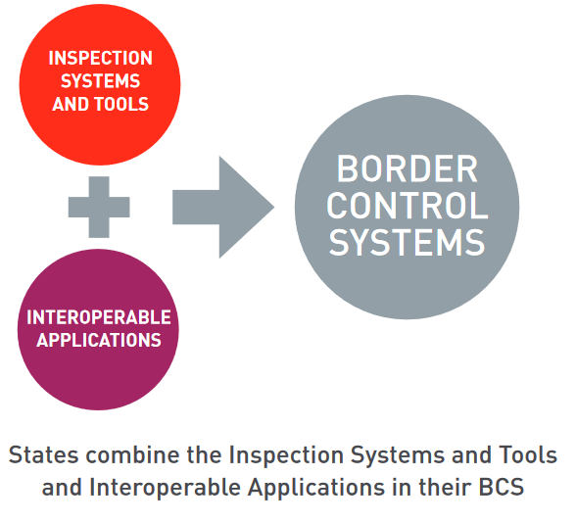
Border Control Systems (BCS)
Notes:
The Border Control Systems (BCS), or ICT Systems, used by States integrate Interoperable Applications with Inspection Systems and Tools. Not all States employ all the available Inspection Systems and Tools and Interoperable Applications. Instead, they integrate them in different ways in their BCM. National BCM use different ICT architectures. The architecture used is less important than the results that are achieved.
All BCS, whatever their architecture, depend on the global interoperability of MRTDs. The data obtained from MRTDs, when added to additional traveller identification and risk assessment data obtained from Interoperable Applications, can be aggregated, disaggregated and analysed to produce statistics and actionable intelligence to facilitate and secure travel. The automated capture, verification, recording and analysis are undertaken in the integrated BCS of States.
10

Slide 11
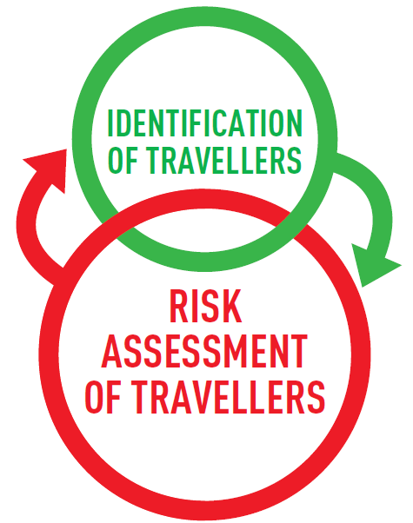
Unifying Concept of the Guide
The Identification of travellers informs, and is informed by, traveller risk assessment.
  An iterative process undertaken throughout the phases of the traveller journey as additional and updated information becomes available about travellers.
Notes:
The unifying concept introduced in the Guide is the iterative process of identification of travellers and risk assessment.
Identification of travellers and risk assessment is repeated at each phase of the traveller journey as new information becomes available to national border control authorities.
Each Inspection Systems and Tool and Interoperable Application (described separately in the Sections 4 and 5 of the Guide) contribute to identification of travellers or traveller risk assessment or both.
11

Slide 12
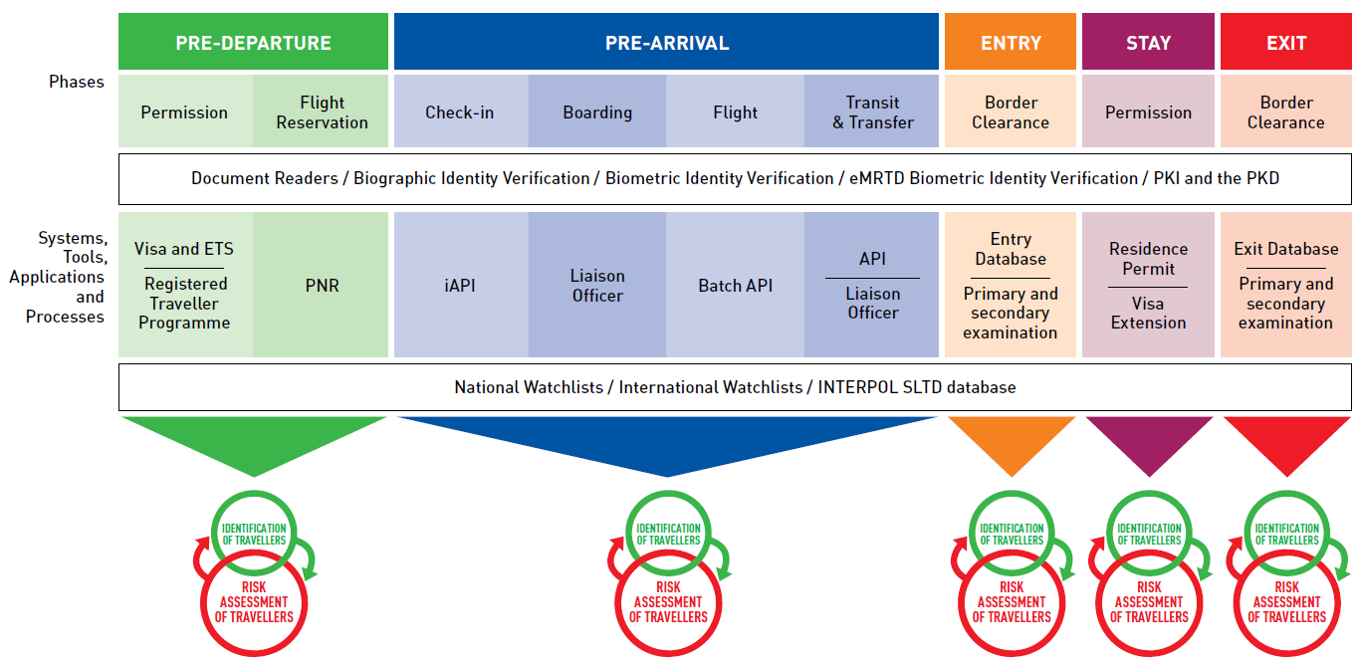
Phases of the Traveller Journey
The traveller journey is illustrated taking the perspective of the receiving State.
Notes:
The traveler journey is illustrated taking the perspective of the receiving/destination State.
The slide reminds us that information about travel and travelers is available to States before travel commences. States with advanced BCM arrangements undertake continuous traveler risk assessment and are able to make interventions to prevent travel from commencing or continuing.
It is the integration of Inspection Systems and Tools with Interoperable Applications in national BCS that allows traveller risk assessment to be undertaken throughout the traveller journey. This assessment is informed by the identification of travellers using the new information that becomes available to transit and destination States at each phase of the journey.
The illustration shows the traveller information that is potentially available to States at each phase of travel.
From the perspective of an individual State, as illustrated in the slide, travel is a process that commences with a pre-departure phase and includes travel, entry, stay and exit.
From the global perspective, travel is a continuum: The same traveller can at the same time be at different phases of the same journey when the perspectives of States of origin and destination of travel are combined.
For example, a traveller at the exit phase from a State can be at the pre-arrival phase for the State of next destination of travel.
Recognizing this continuum is important because it underlines that travel is an interdependent system that requires cooperation and the sharing of data between States, airlines and International and Regional Organizations.
12

Slide 13
iii. STATEGY AND ENVIRONMENT
BCM Environment
Frameworks
National and Regional Collaboration
  Including National Air Transport Facilitation Programme (NATFP)
International Law
Maturity Map
Notes:
Element iii. Strategy and Environment: 6 slides

Slide 14


BCM Environment
Travel patterns are influence by environmental factors:
  e.g. geography, history, economic development, societal factors and conflict.
BCM is a national response to the each State’s environment
  to maximise the benefits of travel while mitigating threat and risk.
Notes:
Effective BCM requires a deep understanding of the benefits, risks and threats of the travel environment that a State faces.
These insights enable States to identify gaps in their national capacity and capability. This understanding in turn ensures that options for applying technology as solutions in BCM can be evaluated, sequenced and prioritized to meet their own needs.

Slide 15
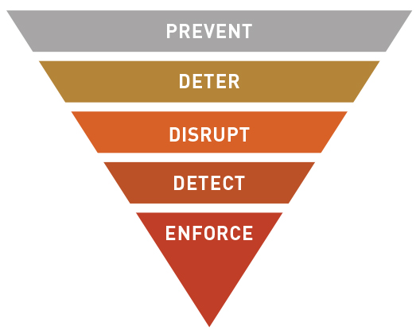
Frameworks
BCM is a regulatory function operating within a State’s policy, legislative and procedural frameworks
National implementation of TRIP must :
  Contribute to achieving policy objectives;
  Be authorised by legislation; and
  Support standard operating procedures.
Notes:
The application of technology in BCM is expensive and carries a high risk of failure wherever objectives and solutions are not clearly aligned with the actual needs of States.
The combination of effective policy, legislative and procedural frameworks that are designed to prevent, deter and disrupt the travel of people who represent a risk or threat to a State provide a strong foundation for successful TRIP Implementation. Gaps and weaknesses in these national frameworks increase TRIP implementation project risk.
15

Slide 16

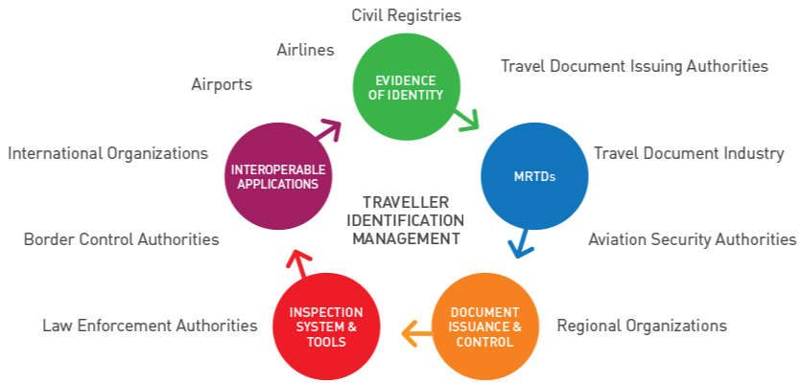
National and Regional Collaboration
Success in BCM requires contributions from:
Mutual understanding of roles and processes builds respect and trust as the foundation for effective communication,
co-ordination and collaboration.
Notes:
The ICAO TRIP Strategy recognizes that traveller identification management requires cooperation within and between government agencies, and with international organizations and private stakeholders.
The complexity of BCM is reflected in the range of public and private stakeholders involved:
Border control agencies responsible for customs, immigration and quarantine clearance;
Agencies responsible for civil registration, and national identity card and travel document issuance;
Agencies responsible for public health;
Law enforcement and security agencies;
Airlines and airport operators; and
International Organizations.
Border controls are stronger when all BCM agencies consider the broader aspects of their interaction with travellers, not just those confined to their own jurisdiction. An ‘all risks, all threats’ approach to BCM.
States around the world come together under regional and bilateral agreements and treaties to strengthen economic, social and political relationships with their neighbours. Securing and facilitating intra-regional travel contributes to maximising these benefits. Regional travel agreements shape and are shaped by regional travel patterns. Understanding regional factors is therefore critical to developing effective national strategies and policies for the identification of travellers.

Slide 17
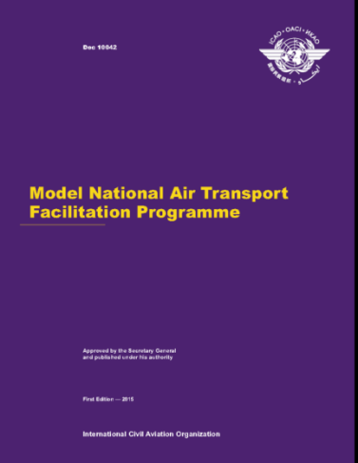
National Air Transport Facilitation Programme (NATFP)
Purpose: Means of coordinating activities between national departments or agencies concerned with or responsible for various aspects of facilitation of national civil aviation
Improve the effectiveness and efficiency of clearance control formalities
Operationalization through national FAL committees
NATFP and National Civil Aviation Security Programme are complementary
Establishing a NATFP is an ICAO Standard
Notes:
One important mechanism for achieving national inter-agency collaboration in BCM is the creation and effective operation of a National Air Transport Facilitation Programme (NATFP). Establishing such a Programme is an ICAO Standard and guidance to States are available in Annex 9 – Facilitation and in the ICAO Doc 10042 Model National Air Transport Facilitation Programme.
The coordination of facilitation activities should take place under a National Air Transport Facilitation Committee and Airport Facilitation Committees, or similar coordinating bodies. The purpose of a NATFP is to facilitate the border-crossing formalities. The meetings of its committees are a forum for consultation and information sharing.
The work of the NATFP and the National Civil Aviation Security Programme are complementary. ICAO recommends that border control agencies participate in both national Facilitation and Aviation Security committees.

Slide 18
International Law
Major UN treaties with direct relevance to BCM :
1944 Convention on International Civil Aviation (ICAO)
1951 United Nations Convention Relating to the Status of Refugees and its 1967 Protoco (UNHCR)
1954 United Nations Convention relating to the Status of Stateless Persons (UNHCR)
2000 United Nations Convention against Transnational Organized Crime and its 2000 Protocols (UNODC)
1948 Universal Declaration of Human Rights and the core international human rights instruments (OHCHR)
UNSCR including BCM related measures :
UNSCR 1373 (2001) on threats to international peace and security caused by terrorist acts
UNSCRs 1267 (1999), 1989 (2011) and 2253 (2015) includes the Consolidated United Nations Security Council Sanctions List (CUNSCSL)
UNSCR 2178 (2014) includes API
UNSCR 2309 (2016) includes implementing ICAO Annex 9 SARPS
UNSCRs 2322 (2016) and 2396 (2017) includes sharing biographic and biometric information about FTFs and other terrorists
UNSCR 2396 (2017) includes API and PNR.
Notes:
Since BCM is concerned with travel across international borders, it operates within a framework of international law. An understanding of the interaction between the various components of international law and national circumstances is therefore critical in determining a State’s priorities in BCM.
In addition to meeting their Treaty obligations, States also need to be aware of the various UN Security Council Resolutions (UNSCR) which call on States to implement BCM measures to combat terrorism and other transnational crime.
18

Slide 19
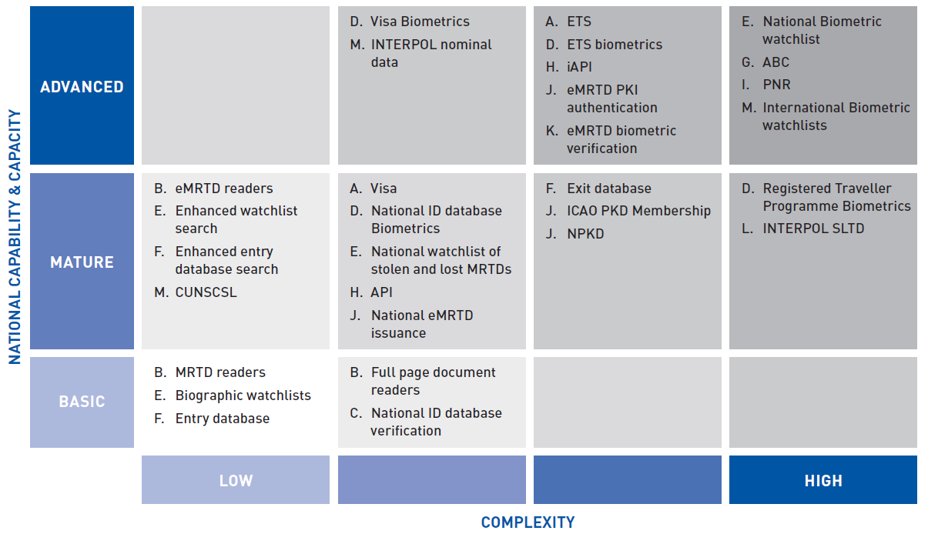
Maturity Map
The essential foundation of a national BCS is a:
an inspection system; with
integrated MRTD readers
More complexity should be added only when budget is available and border agency capability is developed enough to achieve and sustain change.
Notes:
Building a national BCS takes time. As the BCM arrangements of States develop and mature new features are added, their functionality is developed and extended, and integration is improved.
As illustrated, Inspection Systems and Tools and Interoperable Applications can be implemented to different levels of complexity. This complexity is greater when traveller information is obtained and used across the travel continuum (e.g. when visa or ETS data is integrated with the national BCS and when exit controls are introduced).
Inspection Systems and Tools like ABC and Interoperable Applications like iAPI and PNR are complex, as well as expensive. They require advanced capability not only to design and implement but also to operate.
A key question to be answered is whether the ambitions of the national border control agencies match their organisational capability and capacity.
States should ensure all BCM ICT project proposals clearly set out the border security threats they are designed to address, the facilitation benefits they will deliver, the project implementation risks and how they will be mitigated, and the project costs and benefits.
19

Slide 20
iv. TRIP IMPLEMENTATION
Inspection Systems and Tools; and
Interoperable Applications
Notes:
Element iv. Trip Implementation: 19 slides
TRIP Implementation in BCM is the major focus of the Guide and of this presentation

Slide 21
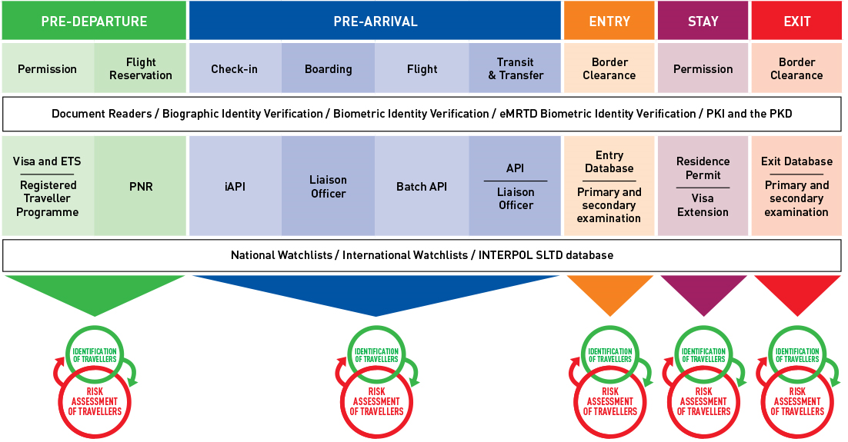
Inspection Systems and Tools, Interoperable Applications and the traveller journey
Systems, Tools and Applications applied across the phases of the traveller journey
Systems, Tools and Applications applied at specific phases of the traveller journey
Notes:
The Inspection Systems and Tools and Interoperable Applications of the ICAO TRIP Guide on BCM are discussed in this presentation in the context of the phases of the traveller journey. Some Inspection Systems and Tools and Interoperable Applications are applied by States at specific phases of the traveller journey while others are used at all phases of travel.
The presentation commences with those that are applied across the phases of the traveller journey and concluding with those applied at specific phases.
Across the phases (the letter corresponds to the topic of the Guide):
B. Document Readers
C. Biographic Identity Verification
J. Public Key Infrastructure (PKI) and the ICAO Public Key Directory (PKD)
K. eMRTD Biometric Identity Verification
D. Biometric Identity Verification
E. National Watchlists
L. INTERPOL SLTD
M. International Watchlists
Specific phases (the letter corresponds to the topic of the Guide):
Pre-Departure Phase:
A. Visa and Electronic Travel Systems (ETS)
I. Passenger Name Record (PNR)
Pre-Arrival Phase:
H. Advance Passenger Information (API) and Interactive (API)
Liaison Officers
Entry, Stay and Exit Phases:
F. Entry & Exit databases
G. Automated Border Controls (ABC)
21

Slide 22
Across the phases of the traveller journey
Some contribute primarily to identification of travellers:
Document Readers
Biographic Identity Verification
Biometric Identity Verification
PKI and PKD
eMRTD Biometric Identity Verification
Others contribute primarily to traveller risk assessment:
National Watchlists
International Watchlists
INTERPOL SLTD Database
Notes:
For the Inspection Systems and Tools and Interoperable Applications applied across the phases of travel, some contribute primarily to identification of travellers while other contribute primarily to traveller risk assessment.
22

Slide 23
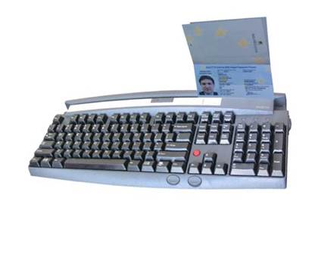
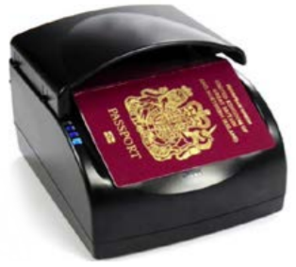
Document Readers
MRTD and eMRTD document readers are the fundamental tool for leveraging the interoperability of MRTDs
The technical specifications of Doc 9303 deal exhaustively with the interoperable features required of document readers.
Notes:
Topic B. Document Readers
MRTD and eMRTD document readers are the tools which leverage the interoperability of MRTDs.
Document readers allow airlines and national authorities to automate aspects of traveller identification and risk assessment across the different phases of travel. Full page readers are more commonly used by States, keyboard swipe readers are more commonly used by airlines.
Document readers are primarily a tool for traveller identification, but their functionality (e.g. check-sum digit calculations and fraudulent document detection) contribute to traveller risk assessment.
The technical specifications of Doc 9303, Machine Readable Travel Documents, deal exhaustively with the interoperable features required of document readers.
23

Slide 24
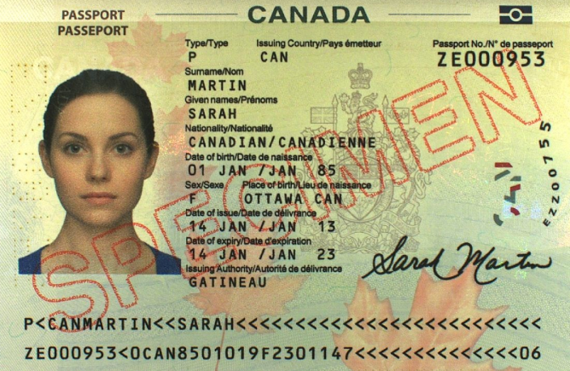
Biographic Identity Verification
Integration of national passport and other national identity data into a State’s BCS can provide a basis for identity verification of citizens and residents.
Notes:
Topic C. Biographic Identity Verification
A comparison of the biographic details read from the MRTD presented by a traveller with the corresponding details recorded in the passport or national ID card issuance database is a simple and readily achieved foundation for identity verification. Integration of a database extract from national passport into the national BCS can automate this important identity verification check at traveller primary processing.
Integration of more detailed national identity data as a reference database for secondary processing provides a good tool to identify imposters.
24

Slide 25

PKI and the ICAO PKD
States upload PKI certificates of the eMRTDs they issue to facilitate the travel of their national document holders to other States.
States download the PKI certificates of eMRTDs issued by other States to authenticate the eMRTDs of travellers to their own State
  before they commence their journey at visa issuance, at entry and at exit.
ICAO Recommended Practice is for States issuing eMRTDs to join the PKD and upload their information to it.
Notes:
Topic J. PKI and the ICAO PKD
eMRTD PKI authentication provides an assurance to States that the travel document being presented by the traveller was genuinely issued and remains unaltered. Membership of the ICAO PKD ensures that the digital certificates essential to perform authentication are conveniently and efficiently available to States from a single, central location.
Since the ICAO PKD is not designed to support the authentication of individual travellers, a NPKD or similar repository, integrated with the national BCS, must be established by States to support eMRTD PKI authentication at the border.
eMRTD authentication contributes to both traveller identification and traveller risk assessment. eMRTD authentication can be applied and relied on across all phases of the traveller journey, provided the required digital certificates are available for comparison.
ICAO SARPs apply to this topic.
25

Slide 26

eMRTD Biometric Identity Verification
Subject to PKI authentication of the eMRTD, biometric images read from the eMRTD can be relied to verify identity by comparison of images taken of the same biometric feature of the traveller.
eMRTD biometric identity verification can be undertaken at different phases of the traveller journey, whenever the eMRTD is presented by the traveller.
ICAO Recommended Practice is for States to join the PKD and use the information available from the PKD to validate eMRTDs at border controls
Notes:
Topic K. eMRTD Biometric Identity Verification
Provided eMRTD PKI authentication is performed correctly (see PKI and the ICAO PKD above), States can rely on the biometric images read from eMRTDs to make comparisons with images of the corresponding biometric feature of travellers. Biometric identity verification using reference facial images obtained from eMRTDs is a universal solution, available to all States, in all eMRTDs, and as a result is the most common identity verification solution to be found in eGate deployments globally. Provided eMRTD PKI authentication is undertaken, eMRTD biometric verification can be applied and relied on across all phases of the traveller journey.
ICAO SARPs apply to this topic.
26

Slide 27

Biometric Identity Verification
Biometric identity verification is achieved by comparing an image of the traveller with a reference image.
The reference image can be enrolled prior to the traveller journey, for instance:
  At visa or ETS issuance;
  As part of a registered traveller programme; or
  Obtained from a national database of passport or ID card.
Effective biometric identity verification solutions have security and process efficiency benefits and can be used at every stage of the traveller journey.
Notes:
Topic D. Biometric Identity Verification
Biometric identity verification adds to the assurance of traveller identification and has the important additional benefit of being readily automated. Those solutions obtain the biometric reference image from other sources (e.g. in passport, ID card, visa or ETS issuance, or in registered traveller programs). Biometric identity verification is a key enabling feature for ABC.
Biometric identity verification using images read from eMRTDs is the subject of Topic eMRTD Biometric Identity Verification.
27

Slide 28

National Watchlists
A national watchlist can include as targets the identity attributes of travellers known to represent a risk or threat to a State.
Advanced search functionality can improve watchlist matching.
Data analysis (e.g. combining travel and visa history, API, PNR and other data sources) can be used to develop temporary risk based interventions targeting specific flights or travellers.
Notes:
Topic E. National Watchlists
The application of watchlists enables States to prevent the travel of and/or to refer for secondary examination, travellers who are known targets following prior risk assessment.
National watchlists automate one important traveller risk assessment task.
With more advanced functionality, national watchlists can be used to apply temporary risk based intelligence profiles to target interventions to specific flights or travellers.
National watchlists can be applied by States at the different phases of the traveller journey – directly by States in visa issuance, at entry, during stay and at exit and indirectly during travel via airline iAPI interfaces and by national liaison officers working at foreign airports.
28

Slide 29
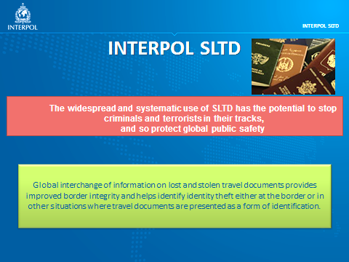
INTERPOL SLTD
Checks against the INTERPOL SLTD provide assurance that travel documents remain in the hands of the traveller to whom they were issued.
INTERPOL SLTD checks require integration with the Border Control Systems of the State; and
Support at secondary examination to resolve referrals
ICAO Recommended Practice is for States to query the MRTDs of travellers against the INTERPOL SLTD
Notes:
Topic L. INTERPOL SLTD
Checks of the INTERPOL SLTD database provides additional assurance to States that travel documents remain in the hands of the traveller to who they were issued. The INTERPOL SLTD database contributes to traveller identification and risk assessment and can be integrated across all phases of the traveller journey where State interventions are able to be made (e.g. including visa/ETS, iAPI, liaison officer, entry, stay and exit).
The technical implementation of the standalone functionality of the INTERPOL SLTD is relatively straightforward however:
For process efficiency reasons, integration with the national BCS is essential in high volume processing environments; and
For effective operation, robust business processes at secondary examination and 24/7/365 referral support via the States Interpol National Central Bureau (NCB) are essential to resolve the very high false positives reported by the system in circumstances where holders of travel documents attempt travel using MRTDs previously reported as lost after they are found.
ICAO SARPs apply to this topic.
29

Slide 30


International Watchlists
To meet their obligations to combat transnational crime, including terrorism, States should integrate checks of INTERPOL nominal data and checks of the Consolidated United Nations Security Council Sanctions List (CUNSCSL) into their national BCS.
UNSCR 2396 (2017) calls on States to implement biometric (& biographic) watchlists to identify terrorists
Notes:
Topic M. International Watchlists
States have obligations to prevent and combat trans-national crime, including terrorism.
A tangible step towards meeting these obligations is the inclusion in national border watchlists of:
- INTERPOL nominal data (broadly the biographical details of the subjects of Red Notices); and
The CUNSCSL.
While standalone checks of the INTERPOL nominal database incorporating CUNCSL are available this option is less preferred, because of its impact on efficient traveller processing in high volume processing airports. Integration of INTERPOL and CUNSCSL listings into national watchlist solutions with advanced search functionality is preferred.
In the future, these obligations may extend to include international biometric watchlist targets.
UNSCR 2396 (2017) calls on States to implement biometric watchlists to identify terrorists.
30

Slide 31
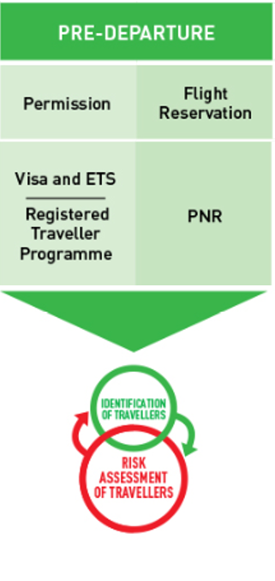
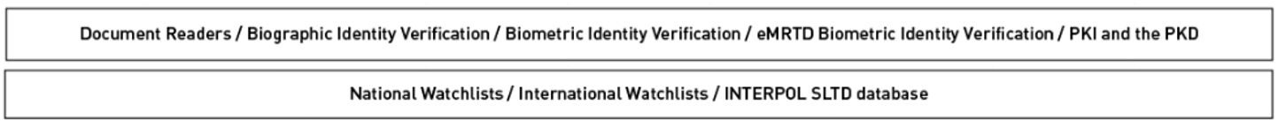
Pre-Departure Phase
Visa & ETS
Biometric Enrolment for Registered Traveller Programme
PNR
Notes:
Pre-Departure Phase
The most common Inspection Systems and Tools and Interoperable Applications used a the Pre-Departure Phase are:
Visa & ETS
Biometric Enrolment for Registered Traveller Programme
PNR
Inspection Systems and Tools and Interoperable Applications that are applied across the travel phases may also be used at the Pre-Departure Phase.
31

Slide 32
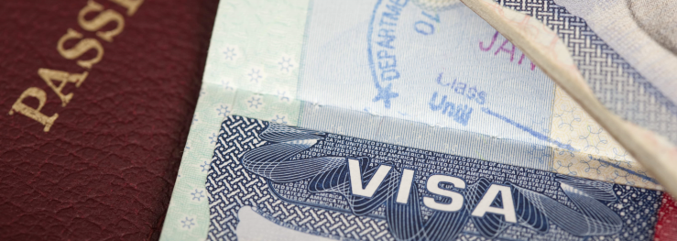
Visa & ETS
Enables risk assessment of travellers before travel commences.
ETS have facilitation benefits over traditional visas, because they are typically quickly and conveniently obtained online.
ICAO Recommended Practice includes guidance on ETS design
Notes:
Topic A. Visa & ETS
Visas and ETS arrangements obtain additional traveller information which allows States to undertake identification and risk assessment prior to travel commencing.
Visa and ETS requirements can prevent and deter high risk travellers from attempting travel. At the same time ETS have facilitation benefits – an ETS is obtained quickly and cheaply in online applications and when integrated with iAPI, provide certainty that airlines can allow travel to commence.
ICAO SARPS apply to this Topic.
32

Slide 33
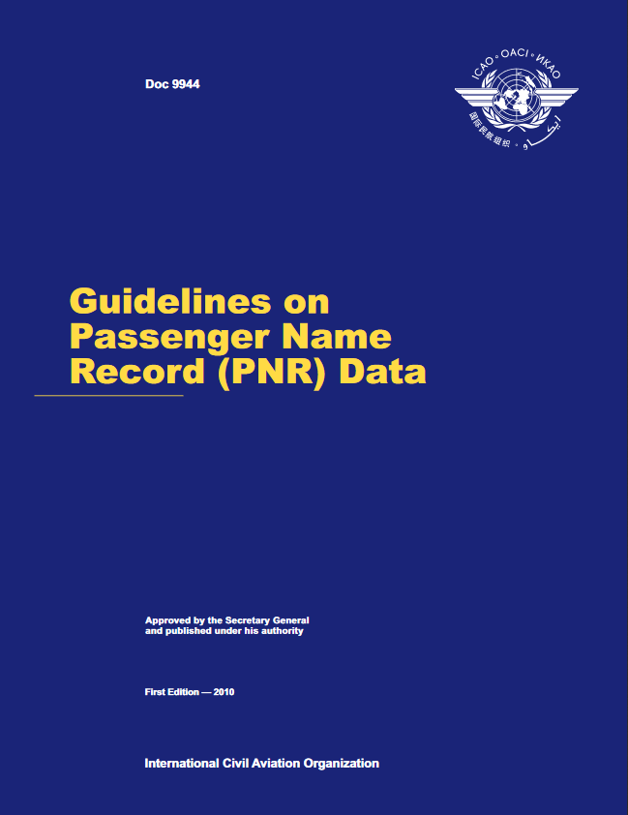
Passenger Name Record
Airline PNR is a rich source of additional data about traveller
but
PNR data is sensitive and must be adequately protected
and
PNR data can only be successfully applied by users with sophisticated investigation and intelligence capability able to use data analysis tools.
UNSCR 2396 (2017) calls on States to implement PNR
Notes:
Topic I. PNR
PNR enables the data that airlines collect about travellers at the time reservations are made to be sent to border control agencies. Since this data includes sensitive personal information, adequate privacy and data protection is essential. As this data is unverified for traveller identity, significant analysis and data management is required to reliably associate the PNR data with the verified identity of the traveller.
Subject to these constraints being adequately managed, PNR data allows States to supplement other risk-based assessments of travellers to identify the travellers whose entry can be facilitated and those that require other interventions.
When used in conjunction with visa/ETS and/or iAPI and/or liaison officers, traveller risk assessment using analysis of PNR can be used to prevent travel from commencing.
ICAO SARPs apply to this topic. UNSCR 2396 (2017) calls on States to implement PNR.
33

Slide 34
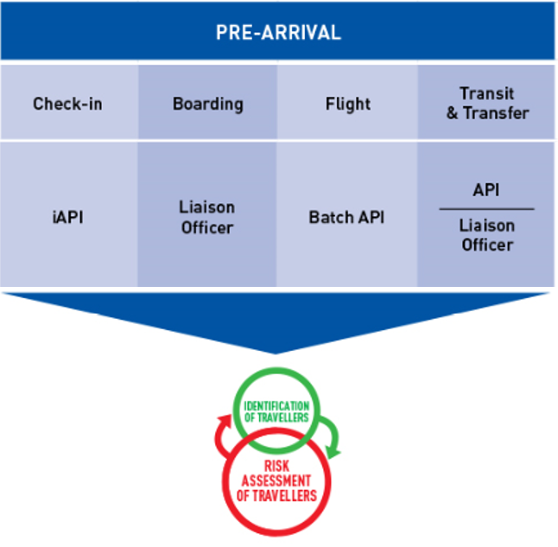
Pre-Arrival Phase
iAPI & API
Liaison Officers
Notes:
Travel commences in the pre-arrival phase.
For long-haul travel, aircraft boarding may be repeated at transit airports where additional travellers transfer to the aircraft operating to their onward or final destination (interline).
Inspection Systems and Tools and Interoperable Applications that are applied across the travel phases may also be used at the Pre-Departure Phase.
34

Slide 35

API and iAPI
Receiving travel document and flight information relating to arriving or departing travellers:
Gives border control agencies additional time to complete traveller identification and risk assessment;
Facilitates pre-clearance; and
In the case of iAPI, can prevent travel commencing by returning a message to airline check-in to refuse boarding.
GUIDELINES ON ADVANCE PASSENGER INFORMATION (API) 2013
UNSCR 2178 (2014) and UNSCR 2396 (2017), amongst others, calls on States to implement API.
Notes:
Topic H. API & iAPI
API enables the traveller MRTD data collected by airlines at check-in to be sent to State border control agencies. Obtaining traveller data in advance of arrival allows States to complete risk-based assessments of travellers to identify the travellers whose entry can be facilitated and those that require other interventions.
iAPI, an enhanced two-way interface, allows States to prevent travel commencing, by returning a message to the airline at check-in to refuse boarding.
ICAO SARPs apply to this topic. UNSCR 2178 (2014) and UNSCR 2396 (2017), amongst others, calls on States to implement API.
35

Slide 36
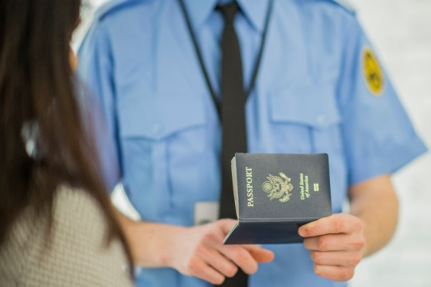
Liaison Officers
Liaison Officers are typically deployed:
  By States at risk of receiving large numbers of inadmissible passengers;
  At the major embarkation and transit airports of travel to the deploying/receiving State;
  With the agreement of the border authorities at the airports where they operate;
  To work with airlines to identify and prevent the onward travel of inadmissible passengers.
ICAO Recommended Practice is to permit liaison officers at airports to assist airlines in travel document examination
Notes:
Liaison Officers
The deployment of liaison officers complements TRIP Implementation by providing a local reference point for airlines and border authorities at check-in, transit, transfer and boarding to resolve doubts, when they arise, of the admissibility of travellers at their destination.
ICAO SARPs apply to this topic.
36

Slide 37
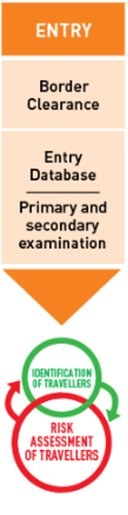
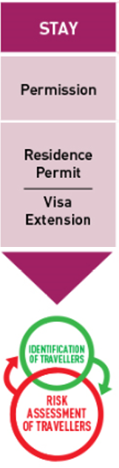
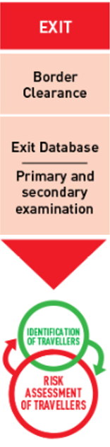

Entry, Stay & Exit Phases
Entry & Exit Databases
Managing Stay (residence permits & visa extensions)
Exit Database
Automated Border Controls
Notes:
From the perspective of the receiving State, the travel journey concludes with the entry, stay and exit of the traveller.
For most States, BCM interventions are most intensive at « entry ».
In more sophisticated States more analysis has been undertaken earlier in the travel journey, and more interventions will occur, according to risk, during stay and at exit.
Inspection Systems and Tools and Interoperable Applications that are applied across the travel phases may also be used at the Pre-Departure Phase.
37

Slide 38

Entry and Exit Databases
A database of the “entry” of all travellers is a foundation for longitudinal analysis
The addition of an “exit” database provides a basis for reconciliation to determine patterns of “stay”
For both “entry” and “exit” databases:
  Reporting of aggregated data reveals patterns and growth e.g. for Tourism policy planning
  Data on individual travellers informs risk identification and analysis
Notes:
Topic F. Entry & Exit databases
A historical database of the prior entry of travellers is on its own a powerful risk assessment tool for States, the value of which increases when analysed in combination with other data sources (e.g. visa/ETS data). For States performing exit controls, the addition of exit data allows States to reconcile traveller arrivals and departures:
For foreigners - to identify visa overstayers and accurately determine overstay rates and trends; and
For nationals - to determine actual residence and accurately report on emigration.
Aggregated travel data provides important insights for States into the economic, social and security issues faced by States. For all purposes, the value of historical databases of travel increases with the size of the database and when full national coverage of all border locations is achieved.
38

Slide 39

Automated Border Controls
Enhances efficiency in traveller processing and identity verification, and enables redeployment of border personnel for targeted interventions to achieve facilitation and security objectives.
ICAO Recommended Practice is for States to consider the introduction of ABC, integrated with integral PKD and INTERPOL SLTD checks, to facilitate air travel
Notes:
Topic G. ABC
In high volume applications, where benefits justify the cost of investment, ABC can improve process efficiency for border control agencies, reduce processing time for the traveller while at the same time improving the assurance of traveller identity and automating aspects of the traveller risk assessment.
The implementation of ABCs is highly contingent – relying at a minimum on the integration of watchlist searches including checks of lost and stolen travel documents and biometric identity verification.
ICAO SARPs apply to this topic.
39

Slide 40

Managing Stay
In advanced BCS, traveller information is used to regulate and determine:
Who is present in the State;
How long they are permitted to remain; and
What conditions are attached to their continued stay?
For States, the ultimate purpose of BCM is to regulate the outcome of the travel process
  the “stay” of travellers in the State.
Notes:
« Stay » is the outcome of the travel process.
For States, the spending by tourists and the deals negotiated by businessmen during their stay deliver the benefits. The threats faced by States from transnational crime, including terrorism, likewise occur mostly after the entry of travellers.
Investments by States in their national BCS should therefore be focussed on improving the States ability to regulate the stay of travellers.
The BCS in advanced States provide individual and aggregated data to report on who is present in the State; how long they are permitted to remain; and the conditions that are attached to their continued stay.
40

Slide 41
v. TRIP IMPLEMENTATION
Risks and Constraints
Notes:
Element v. TRIP Implementation - External Risks and Constraints: 6 slides

Slide 42



Implementation of TRIP in BCM– Risks & Constraints
Five risks to avoid or mitigate for the successful application of TRIP in BCM:
Organisational Capability
Primary and Secondary Examination
Transparency and Governance
Manual and Visual Inspection of Travel Documents
BCM Strategy
Notes:
The application of ICT technology to develop and implement Inspection Systems and Tools and Interoperable Applications is necessary, but not sufficient for successful TRIP Implementation.

Slide 43
Risk #1 Organisational Capability
Complex
The implementation of advanced TRIP Tools and Interoperable Applications is highly contingent on:
Basic inspection systems being in place; and
Deep capability to understand and evaluate options for change
Foundation
Notes:
Advanced tools like ABC and biometric watchlists, and advanced interoperable applications like PNR and API are complex and highly dependent.
As complexity increases, integration becomes more complex and deep insight is required to evaluate options for change.
Once implemented, advanced capability is required for sustained operation.
For example, the administrative challenge of sustaining the collection, collation and distribution of all the PKI certificates from all eMRTD issuing States, into a an NPKD, and to all border locations requires ongoing staffing and technical resources, and technical understanding of eMRTD PKI.
43

Slide 44
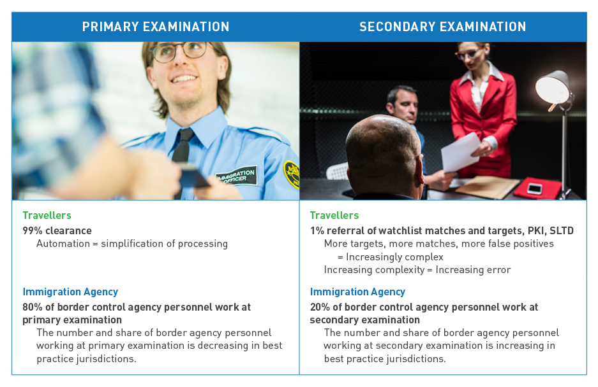
Risk #2 Primary and Secondary Examination
Notes:
Advanced Inspection Systems and Tools and Interoperable Applications generate process exceptions which need to be resolved at secondary examination.
INTERPOL SLTD checks;
other watchlist searches;
eMRTD PKI authentication;
API;
iAPI;
PNR; and
ABC
The process exceptions are comprised in large part of “false positive matches” but these must be examined and resolved to distinguish them from “genuine hits”.
Successful TRIP implementation requires a disciplined separation of staffing resources between primary and secondary examination.
This separation must be able to be sustained at all times and in particular should not be diluted during processing peaks.
44

Slide 45



Risk #3 Transparency and Governance
The risk of corruption in BCM needs to be assessed and mitigated by States so that their investments in TRIP implementation can be successful.
Notes:
Section 7.2 of the Guide provides suggestions to States for actions to improve governance and transparency.
The application of technology in TRIP Implementation can help identify, but can’t defeat, corrupt border control management practice.
Transparency International provides an objective, external assessment of perceptions of corruption for many States.
45

Slide 46
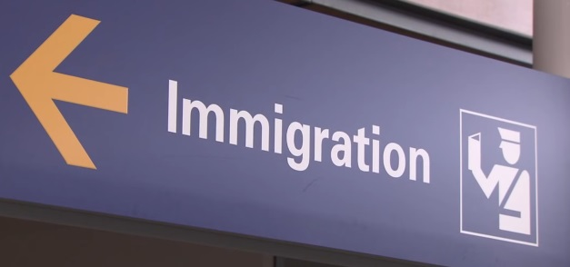
Risk #4 Manual & Visual Inspection of Travel Documents
Notes:
TRIP implementation can improve security and facilitation outcomes and efficiency of processing but the manual inspection of travel documents remains important, in particular at secondary examination, to contribute to the resolution of referrals from primary examination.
46

Slide 47
Risk #5 BCM Strategy
  About this Guide – Scope and Application
  ICAO TRIP and Border Control Management
  National Strategies for Border Control Management
  National Border Inspections Systems and Tools
  Interoperable Applications
  Traveller Examination and Travel Document Inspection
  Operational and Human Considerations in Border Control Management
  Assistance to States
Foundation
TRIP Implementation
Notes:
A documented national BCM strategy, aligned with the development objectives of the State, provides the best guarantee that investments in TRIP technology will be able to be properly evaluated for cost and benefits.
47

Slide 48
vi. CONCLUSION
Assistance to States
ICAO Contact Information
Notes:
Element vi. Conclusion: 2 slides

Slide 49







Assistance to States
ICAO hosts events; develops and publishes SARPs, technical specifications and guidance material; and works with partners to provide technical assistance supporting TRIP implementation
Notes:
ICAO and other international organizations can provide assistance to States to achieve TRIP Implementation.
49

Slide 50
Security & Facilitation
International Civil Aviation Organization
999 Robert-Bourassa Boulevard
Montréal, QC, Canada H3C 5H7
Email: fal@icao.int
Tel: + 1 514 954-9219
Fax: +1 514 954-6077
www.icao.int/Security/FAL/TRIP
Notes:
To ask questions or communicate with the Facilitation Section, States are invited to write to: FAL@icao.int
50

