Slide 1

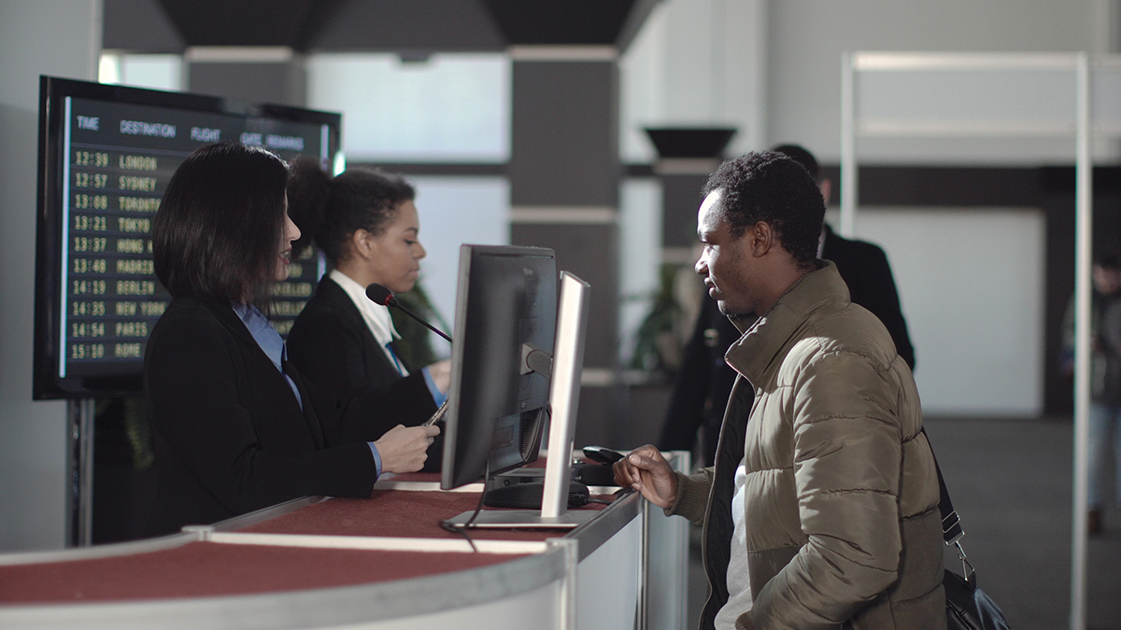

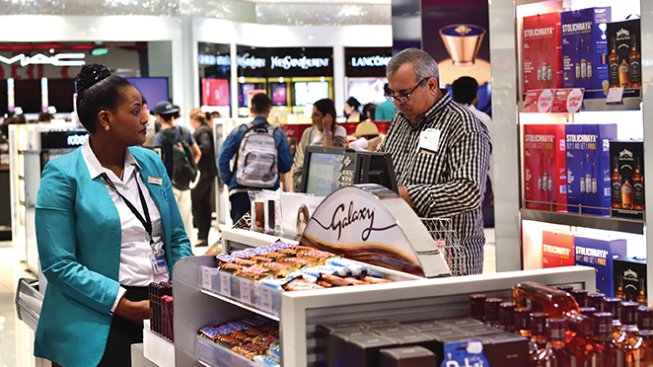
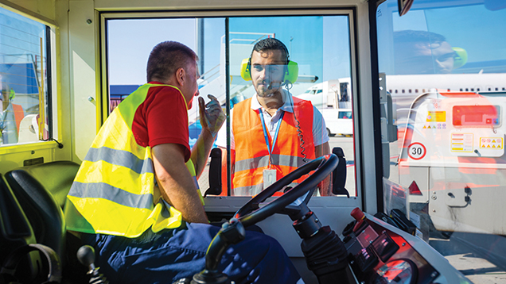
Security is everyone’s responsibility
Security Culture Briefing
© ICAO 2022
Notes:
The slide pack is a resource that managers can use to help brief their staff on security culture.

Slide 2


Purpose of this briefing
To explain the concept of security culture and why it matters
To encourage the right security behaviours and actions by all staff
To ensure everyone understands the role they play in keeping aviation safe and secure
© ICAO 2022

Slide 3

What is security culture?
It refers to the norms, values, attitudes and assumptions which guide the actions and behaviours of our workforce – culture refers to the way ‘things are done in the organization’. A positive security culture helps keep us safe and secure.
For us this means:
Recognizing that effective security is critical to our business success
Everyone understanding that security is their responsibility
Ensuring that our reporting procedures are clear and encourage the reporting of security concerns
Creating a working environment which promotes ‘doing the right thing’
© ICAO 2022

Slide 4
What do we need from you?
Follow
Follow security policies and procedures – they are there to protect you and our organization
Report
Report anything unusual or suspicious – using local reporting channels
Provide
Provide feedback on how and where we can improve security – we want to hear from you
Lead by
Lead by example and display positive security behaviours
© ICAO 2022

Slide 5
Tools & resources
Posters
Wallet Cards
Flyers
Email and intranet articles
Checklists
© ICAO 2022

Slide 6
Key messages
The threats to aviation are evolving. We cannot afford to be complacent
We have a range of security measures in place to help keep you safe and secure. But you also have a key role to play – be alert for any unusual activity and report suspicious behaviour
Though our actions we can develop a strong and effective security culture
© ICAO 2022

Slide 7
Useful information
ICAO Security Culture Website
https://www.icao.int/Security/Security-Culture/Pages/default.aspx
ICAO Best Practices & Guidance
https://www.icao.int/Security/Security-Culture/Pages/Best-practices.aspx
ICAO Security Culture Self-Assessment Tool
https://www.icao.int/Security/Security-Culture/Pages/State-self-assessment.aspx
FAQs on Security Culture
https://www.icao.int/Security/Security-Culture/Pages/FAQs.aspx
© ICAO 2022

