Slide 1
BACKGROUND AND OBJECTIVES
Module 1
Prosper Zo’o Minto’o
Deputy Regional Director, Western and Central Africa
International Civil Aviation Organization (ICAO)
Regional Workshop on African ANSP Peer Review Programme Manual
25-27 April 2018, Grand Bassam, Cote d’Ivoire

Slide 2
Outline
Air Traffic Forecast
Global Planning & Implementation Framework
Main Challenges
  USOAP CMA Audit Results
  Propsals for Enhancements
African ANSP Peer Review Programme
  Background & Objectives

Slide 3
Growth of Air Transport
+3.8%
vs. 2015
205 billion FTK
+7.4%
growth rate vs. 2015
7.1 trillion RPK
Source: ICAO Annual Report of the Council
Scheduled commercial traffic
Total (international and domestic) services
Notes:
And we know that the challenges will not lessen, but grow in time considering that the forecast does not indicate reduction in the aviation activities, exactly the opposite, and with new entrants and airspace user, complexity of operations will also be a factor to be considered.

Slide 4
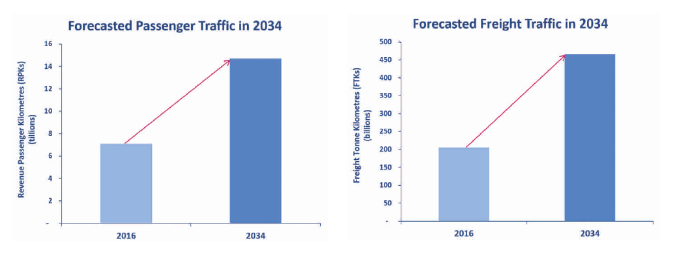
Air traffic will double by 2034
SOURCE: ICAO LONg-term traffic forecasts
Notes:
And the challenges are not only related to the growth of aircraft movements, but also passengers, what will put pressure on airport infrastructure.

Slide 5
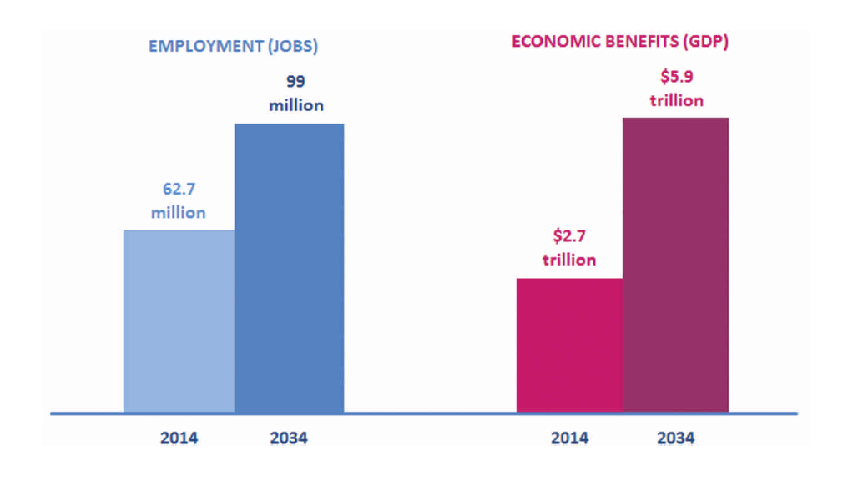
Estimated Economic Benefits Growth
SOURCE: Aviation benefits beyond borders, 2016, atag
Notes:
And we, as a State, Regulator or Service provider have a crucial role to play to face the challenges considering that the air transport has a significant impact on the modern global economy. It generates 3.5% of the world’s GDP, USD 2.7 trillion, with the support of 62.7 million jobs worldwide.
Direct impacts
Indirect impacts
Induced impacts

Slide 6
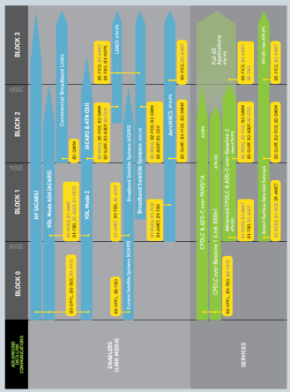
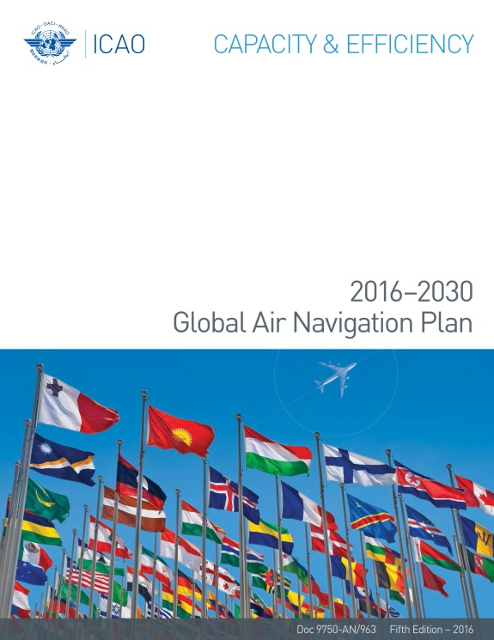
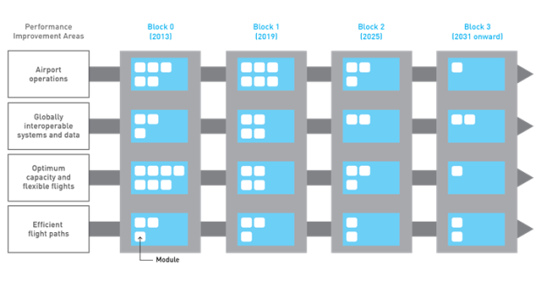
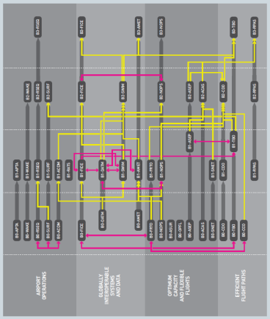

Contents of the 2016-2030 GANP
Aviation System Block Upgrades (ASBU) Methodology
Technology Roadmaps and
Module Dependencies
Notes:
Twelve years ago the aviation community realized the need to guide the future of global air navigation by fostering the implementation of a seamless, global ATM system and published the first Global Air Navigation Plan in 2002.
This plan was technology driven, meaning by this that provisions were developed to standardized the use of technology. However at one point in time, ICAO realized that technology was evolving at an increasingly faster rate and that much of the technology that existed or was in development would changed or ceased to exist by the time the provisions to support their implementation were developed. In addition, ground and on-board technology progressed independently at different rates, so the focus on technology generated, among other things, a disconnect between the ground and on-board capabilities.
Therefore ICAO recognized that technology is not an end in itself and the planning of global air navigation moved from a technology driven approach to a performance-based one. That is why since 2013, desired level of performance are defined, operational improvements to achieve this performance are identified and the necessary technology to enable these operational improvements is developed. These operational improvements are organized in a framework called Aviation System Block Upgrade framework. This global operational framework provides a consensus-driven modernization strategy for integrated planning based on performance. It allows all Member States to advance their air navigation capabilities based on their specific operational requirements and at the same time helps manufacturers, service providers and regulators understand where their system is in comparison with other ANSPs with similar profiles.
Although the operational improvements descried in the aviation system block upgrades (ASBU) framework are not mandatory and they should not be implemented everywhere, but only where there is an specific operational scenario where an area of the performance of the system needs to be improved, the GANP identifies three areas of priority:
Performance-based navigation
Continuous climb and decent operations (CCO/CDO)
Air traffic flow management (ATFM)

Slide 7
Global Planning & Implementation Framework
Chicago Convention & Annexes (SARPs)
Implementation: Guidance, Support, Facilitation, Monitoring and Follow up
Regional Office work programmes
Regional Plans and Targets (Safety, Air Navigation, Security)
linked to APIRG, RASG-AFI, AFI Plan, AFI SECFAL Plan Programmes
Global Plans for Air Navigation and Safety (GANP, GASP, GASeP)
ICAO Strategic Objectives
ICAO Audit State CAPs, ICAO Plans of Action, AVSEC SIPs, National Plans
GLOBAL
REGIONAL
NATIONAL

Slide 8
Main Challenges
Member States:
  Need for national, regional and global air navigation planning alignment
  Not same implementation needs
  Optimize allocation and use of resources for air navigation
Secretariat:
  Need to improve the communication with different stakeholders to better explain the purpose of the ASBU framework
  Need to provide better guidance on how stakeholders would benefit if focused on performance
Notes:
Based on consultation with member States, we have ascertained the following challenges when implementing the current areas of priority of the GANP:
It is challenging for some States to make the best allocation and use of the available resources when they do not know their needs. The lack of need analysis and national air navigation planning or strategy drive States to invest in systems that they do not need to solve problems that they do not have. Not all the States have the same implementation needs, some of them are facing problems with capacity, others with efficiency or interoperability. In addition, there is not one unique best solution for States with the same problem, due to the different operational scenarios. Resources are always limited and States that know what they need and the challenges they are facing, are reticent to invest in specific implementation solutions that might not solve their problems.
Secretariat is also facing some challenges for improved understanding:
ICAO needs a campaign to improve the common understanding of the ASBU framework and the method to be followed for the proper utilization of the ASBU framework based on needs analysis and identification of optimum solutions. Due to the different States needs, this method should be based on a need analysis and optimum solution identification to improve the overall performance of the air navigation system making the best of the resources available.
A mechanism is needed to assist the States in the definition of national air navigation planning strategies within the national development umbrella to ensure the necessary investments in the air navigation system to cope with challenges such as the increase in traffic, the increase in the number and type of airspace users in a safe, secure and sustainable manner. The focus should be in the final performance expected from the system. As well as in the GASP, there is a need for greater emphasis on implementation support, by way of tools, subject matter expertise sharing and workshops.

Slide 9
Current Status – Safety
Impact of Training and Qualification of Personnel on Safety Oversight Implementation (2017)
2007
AFI ICAO USOAP Results – Average EI & CE-4 EI by State
NCLB Aspirational goal: No State with an EI < 40% for any CE by 2025
24 African States out of 27 that have an EI in CE-4 ≥ 40% also have an EI ≥ 60%
All African States that have had an SSC also have an EI in CE-4 < 30%
EI (%) - CE 4
__________________________________________________________________________________________________
__________________________________________________________________________________________________

Slide 10
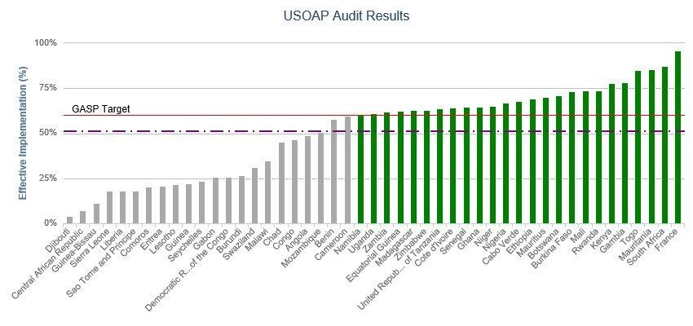

Slide 11
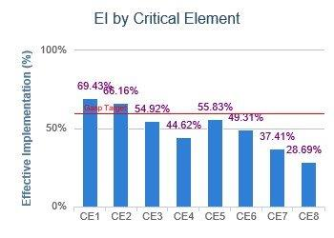
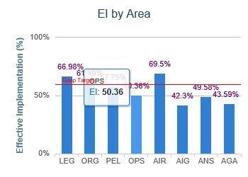
USOAP Results

Slide 12
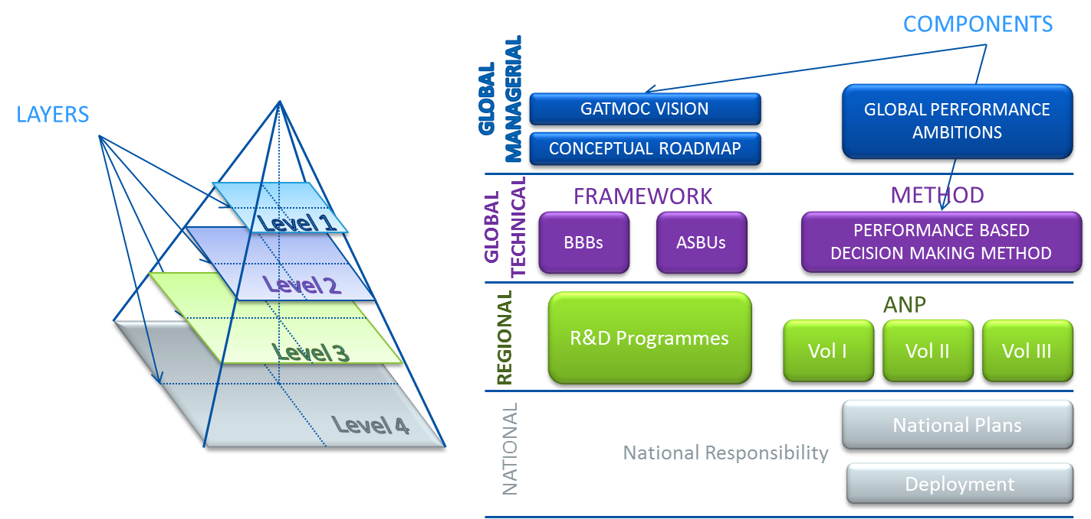
Proposals for Enhancement
2019 Update of GANP:
Creating a Multilayer Structure
Notes:
And in order to address these challenges and make the GANP relevant for our member States, ICAO is proposing a multilayer structure for the GANP 2019. This multilayer structure will support States on improving the performance of the system through the implementation of air navigation improvements making the best use of the available resources .
The highest level will be the front door for all stakeholders to ICAO, it will be a document written in executive language, endorsed at the highest political level. It will contain a vision, Global Performance Ambitions and a conceptual roadmap. The vision will highlight the importance of air navigation on the national system and economy. The performance ambitions are aspirational and provide high-level strategy and policy orientations to promote the need for action and gain the political will. The performance ambitions are supported by the conceptual roadmap as the driver for the evolution of the global air navigation system. In particular, the conceptual roadmap reflects the needs of the system to cope, in the coming years, with the traffic forecast as well as the new types of air operations and airspace users with different operational requirements.
The technical level will be a web based application from which reports (paper) would be able to be derived. It will contain the definition of Basic Building Blocks to build the backbone of an air navigation system, a review of the ASBU framework focused on implementation, a performance-based method for defining strategic implementation of air navigation improvements and the further development of the Key Performance Indicators Catalogue.
The Regional level will contain the ICAO Regional Air Navigation Plans and other Regional initiatives and with the fourth level, Global, Regional and national planning will be aligned.

Slide 13
Global Planning & Implementation Framework
Global Plans
Regional Groups

Slide 14
No Country Left Behind Initiative
The full compliance of the civil aviation system with ICAO SARPs and national regulations requires adequate resources (funding, qualified personnel etc.)
Applicable across the board :
  Regulatory authority
  Air operators
  Airports operators
  Air Navigation Services Providers

Slide 15

The No Country Left Behind (NCLB) campaign
Launched by ICAO Council at the end of 2014:
highlights ICAO’s efforts to assist States in implementing ICAO Standards and Recommended Practices (SARPs).
The main goal of this work is to help ensure that SARP implementation is better harmonized globally
that all States have access to the significant socio-economic benefits of safe and reliable air transport.
promotes ICAO’s efforts to resolve SSCs brought to light through ICAO’s safety oversight audits , as well as other safety, security and emissions-related objectives.

Slide 16
African ANSP Peer Review Programme
  Background
  The African Air Navigation Services Providers (ANSP) Peer Support programme was first mooted by the President of the ICAO Council during the Coordination Meeting between African ANSPs in Montreal on 4 February 2015, where he called for a peer review among and between ANSPs as “a very tangible mechanism to improve the capabilities of ANSPs as part of ICAO’s No State left behind goal.”

Slide 17
African ANSP Peer Review Programme
  Subsequent to the aforementioned meetings, a Coordination Meeting of African ANSPs was held in Durban, South Africa on 12 June 2015, to deliberate further on the mechanics and future deliverables of the ANSP Peer Support Programme. The terms of reference (TOR) of the ANSPs Peer Support Programme / AQSA would be adopted following consultations with the AASG
  ICAO plays an active role to support this initiative through providing basic information and the materials to facilitate the commencement of the peer support programme.

Slide 18
African ANSP Peer Review Programme
  This suggestion gained traction at the follow-up African ANSPs Coordination Meeting in Madrid on 7 March 2015, where an agreement was made to establish the African ANSP Steering Group (AASG)
    Chaired by ASECNA and Vice-chaired by ATNS Comprising Ghana, Kenya, Mozambique, Nigeria, CANSO and ICAO as the founding members to enhance the performances of African ANSPs.
    AFCAC will be an observer/participant in the AASG.

Slide 19
  Basis
Under the auspices of the AASG, a framework agreement among the ANSP Partners should be in place to facilitate the commencement of the ANSP Peer Support Programme.
The TOR of the Programme were proposed by ASECNA in Madrid on 7 March and adopted at the Durban Meeting on 12 June.
The finalised version of the TOR will serve as a guide for the conduct of the Programme.

Slide 20
  The coordination meeting held in Montreal on 1 October 2017:
  Recognized that everyone has a role to play to work towards the success of the peer review programme.
  Recommended that a meeting of ANSPs be convened with the support of ICAO in order to facilitate
Establishment of a Regional Framework of Cooperation Among African ANSPs
Scope definition
Identification of the meeting point between specific projects and the yet-to-be-defined specific responsibilities/role of the AASG
Develop reporting processes
Maintain a coordinated approach
Align the various efforts on the African ANSP peer review programme made thus far
Plan and develop the work programme for the remaining part of 2016 through 2018; and
Assign responsibilities to the Steering Group

Slide 21
AFI Plan Project on ANSP Peer Review Programme
  General
  Project phases
  Project Team
  Beneficiary States personnel

Slide 22
General
Title: Implementation of African Air Navigation Service Providers Peer Review Programme
Beneficiary States: All Africa-Indian Ocean States
Objective: To establish a peer review mechanism among and between ANSPs to improve the capabilities of the ANSPs and enhance the safety and quality of air navigation services in the Africa-Indian Ocean Region.
Duration: 06 months
Funding: AFI Plan budget
Estimated cost: US$ 77,931
Implementation agencies: ICAO/African ANSPs/CANSO

Slide 23
End of Project Status/Targets/ Objectives
  The following is expected by the end of the Project:
    A uniform and sustainable level of safety which should at least be equal to the international requirements has been established for the African Region;
    Increased compliance of States with their obligations under the Chicago Convention with respect to air navigation services, including requirements in: ATS, PANS/OPS, AIS, MAP, MET, CNS, SAR, SMS and QMS;
    Reduced ANSP safety and quality assurance programme costs through pooling of toolkits, human resources and available training.

Slide 24
End of Project Status/Targets/ Objectives
  The following is expected by the end of the Project:
    Effective preparation of ANSPs in the process towards safety oversight/certification by Civil Aviation Authorities;
    Assurance on the continuous improvement of the safety and quality of air navigation services in the AFI region;
    Assurance of a minimum level of operational air navigation safety in States (no ANSP Left Behind).

Slide 25
Programme Strategy
Establishment of a mechanism of action, including:
    Creation of a Coordination Team (CT) of Executives appointed by the ANSPs;
    Draft a frame document (MOU) which specifies the terms of cooperation (modalities of assistance and review by peers);
    Define a standardized frame of reference: all ANSPs will have at their disposal a SMS and a SMQ both integrated (or not);

Slide 26
Programme Strategy
Establishment of a mechanism of action, including:
Establish a partnership (MOU) with other organizations (ICAO, RSOO, CAAs, etc.), in order to take advantage of their experts in relevant air navigation fields, as necessary;
Identify and establish a database of competent experts in all ANS areas of the region;
Develop reference documentation (programme manual, applicable standards, review questionnaire, checklists, reviewer qualification requirements).

Slide 27
Conduct of Peer Reviews
Reviews are carried out by teams of qualified Reviewers. No Reviewer can be part of the team mandated to review his/her own organization;
The review reports are sent to the concerned ANSP which will develop the corrective/preventive action plans accordingly;
The corrective/preventive action plans are returned to the CT which will conduct a regular assessment of the status of implementation.

Slide 28
Launch of the Project
Purpose:
  Sensitize Stakeholders on the objectives of the AFI Plan ANSP Peer Review Project
  Adopt the AFI Plan Project Document
  Secure the commitment of Top Management to the ANSP Peer Review Framework of Cooperation
  Develop an implementation Roadmap for ANSP Peer Review activities
Date and venue: 3-5 May 2017, Freetown (Sierra Leone)
  AFI Plan African ANSP Peer Revie Project Implementation Quarterly Report - 26 April 2018.pdf
Participants: ANSP States & Organizations, CAAs, AFCAC

Slide 29
Project Implementation Strategy
The Project will be implemented by:
  the ICAO Regional Offices accredited to African States, and
  a Team of Experts from among ANSPs and Industry that will provide technical support on a needs basis via review missions or remote documentation review and drafting.
Composition of the Project Team:
ICAO
  Deputy Regional Director, HQ/ANB Experts, ROs/ANS
ANSPs
  Experts selected based on agreed criteria
Industry
  ANS Experts from CANSO

Slide 30
Project Implementation Strategy
  The initial stage of the Project consisted of a Three-Day Regional Meeting of all African ANSPs to establish a mechanism of action and a framework of cooperation, and adopt the operational documentation and the modalities for the implementation of the Review Programme.
  Following the establishment of the mechanism of action for the Review Programme, the assistance will comprise a familiarization workshop on the Review Programme Manual and ANSP Peer Review activities to African ANSPs selected for the pilot reviews.
  Sensitization actions is also required at a senior level in CAAs to secure their support and facilitate the successful completion of this Project.

Slide 31
Conduct of ANSP Peer Reviews
Purpose: Assist ANSP in the conduct of Peer Reviews
Activities:
  On site mission of Project team to each beneficiary ANSP
  Assistance in the conduct of the Peer Review
Duration: 5 days per State/ANSP
Responsible: Beneficiary ANSP and Project Team

Slide 32
Monitoring of the implementation
Purpose: Ensure the effective implementation of agreed corrective action plans
Activities:
  Assign to each Expert ANSP for the monitoring
  Remote monitoring by Experts of the implementation of the action plans
  Beneficiary ANSP to forward to ICAO, monthly reports on the progress in the implementation of action plans
Duration: XX months
Responsible: Beneficiary States, ICAO Regional Office, Project Team

Slide 33
Review of the Peer Review Process
Purpose:
  Conduct a wrap up of the whole Peer Review process to ensure its compliance with agreed framework of cooperation and reference documentation; and
  Development of Final Report on the Project
Activities: Meeting of African ANSP Steering Group
Duration: 3 days
Responsible: African ANSP Steering Group, ICAO HQ and ROs, AFCAC

Slide 34
Project Phases
Approval of AFI Plan
ANSP Peer Review Project
Project promotion /
Stakeholders sensitization
Since 27 June 2016
(AFI Plan SC/17)
Development of Programme Reference Framework
3-5 May 2017
Preparation & Conduct of at least two Pilot ANSP Peer Reviews
April / July 2018
Implementation of Recommendations (CAPs)
TBD
Creation of African ANSP Steering Group
12 June 2015
AFI ANSP Meeting:
Launch of AFI Plan Project + Endorsement of Cooperation Framework & Roadmap
3-5 May 2017
Establishment of Teams of Reviewers
TBD
Dissemination of review reports
TBD
Wrap up and Project Report
November 2018 (AFI Plan SC/22)

