Slide 1
ICAO AFI Plan African ANSP
Peer Review Project -
Regional Workshop
Abidjan, Côte d’Ivoire, 25-27 April 2018
Presented by: ICAO

Slide 2
Objectives of the African ANSPs Peer Support Programme
Governance Structure
Scope & Methodology of the Programme
Guiding Principles and Values
Review Areas

Slide 3
Objectives of the African ANSPs Peer Support Programme
Processes
Programme Records and Confidentiality
Language
Onsite Activity Team Composition
Selection and Training of Reviewers and SMEs

Slide 4
Objectives of the African ANSPs Peer Support Programme
Programme aims to promote continuous improvements
A structured framework to develop corrective action plans
Achieve measurable common performance standards, uniform level of safety for AFI region
Fostering cooperation, promote trust and confidence among ANSPs

Slide 5
Objectives of the African ANSPs Peer Support Programme
Programme does not address / supersede regulatory aspects of safety oversight system
Highlight areas where improvements should be made at the ANSP operational level
Establish a peer review mechanism among ANSPs (akin to IOSA for airlines and APEX for airports

Slide 6
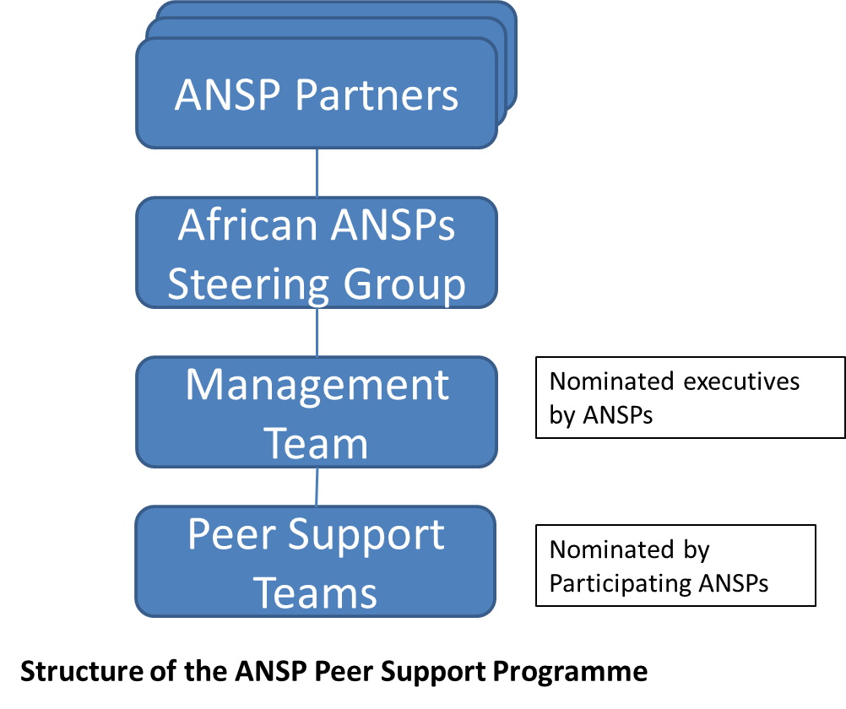
Governance Structure

Slide 7
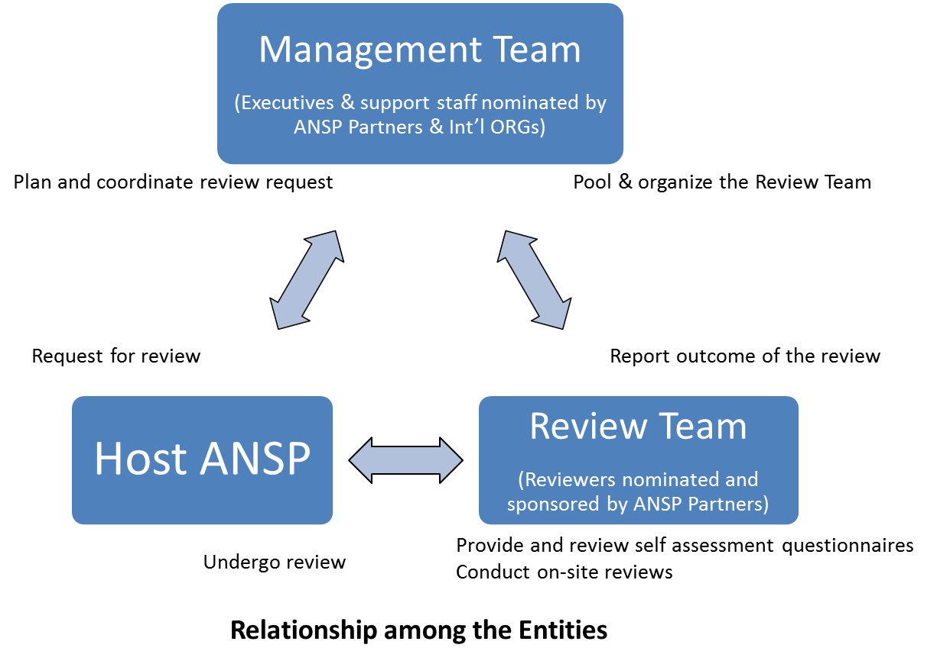

Slide 8
The African ANSPs Steering Group (AASG) is to:
Coordination Team composed of executives appointed by the ANSP members
Exercise Overview of the Programme
Provide direction and guidance whenever necessary.
Conduct periodic review of the Programme
Monitor the development and trend from peer support /reviews

Slide 9
The Management Team (MT)
Select and manage pool of ANS experts from ANSPs & Intl Orgs
Organise review missions for ANSPs requesting peer support
Fulltime staff sponsored or seconded by ANSP Partners & Intl Orgs
Responsible for managing the programme (development, implementation, maintenance and quality)

Slide 10
The Host ANSP
Nominate a focal point to coordinate with the MT
Submit, maintain and/or update information to the MT
provide compliance status through PQ self-assessment
mitigating measures taken in response to observations during review
develop, update and implementation of CAPs

Slide 11
The Host ANSP
provide evidence related to PQ compliance and CAP implementation
facilitate onsite support and visit to its facilities when requested
follow-up with response/action plan in response to the recommendations made
observation deemed critical / urgent should be addressed without delay

Slide 12
Scope & Methodology of the Programme
The scope and content of the Programme will be based largely on the operational aspects of ICAO ANS-related Annexes and PANS where applicable, and have relevance to the ICAO Safety Oversight Audit eight critical elements (CEs).

Slide 13
Guiding Principles and Values
Transparency. The Programme activities shall be conducted under a process that is fully transparent and open for examination by all parties concerned.
Timeliness. Results of the Programme activities shall be produced by the peer support review team in a timely manner, in accordance with a predetermined schedule

Slide 14
Guiding Principles and Values
All-inclusiveness. The scope of the Programme includes the ICAO SARPs contained in all ANS-related Annexes to the Convention, Procedures for Air Navigation Services (PANS), guidance material and related procedures and practices
Systematic, consistent and objective. The Programme shall be conducted in a systematic, consistent and objective manner.

Slide 15
Guiding Principles and Values
Fairness. The Programme activities shall be conducted in a manner such that ANSP Partners have every opportunity to monitor, comment on, and respond to the processes.

Slide 16
Quality. The quality of the Programme activities shall be ensured by assigning trained and qualified reviewers and SMEs to conduct the Programme activities
Ethical conduct: the foundation of professionalism
Fair presentation: the obligation to report truthfully and accurately

Slide 17
Due professional care: the application of diligence and judgement in the conduct of the Programme activities.
Independence: the basis for the impartiality of the Programme activities and the objectivity of the conclusions
Evidence-based approach: the rational method for reaching reliable and reproducible conclusions in a systematic process.

Slide 18
Review Areas
The following review areas have been identified in the Programme:
Air traffic services (ATS);
Flight procedures design (PANS OPS);
Aeronautical information service (AIS);

Slide 19
Review Areas
The following review areas have been identified in the Programme:
Meteorological service (MET);
Communications, Navigation, Surveillance (CNS);
Search and rescue (SAR); and
Safety Management System (SMS).

Slide 20
Processes: Programme Protocol Questions
Protocol Questions (PQs) are the primary tool for assessing the level of effective implementation of an ANSP’s procedures and processes.
The PQs are based on ANS-related ICAO SARPs, PANS, ICAO documents and other guidance materials.

Slide 21
Processes: Programme Protocol Questions
The use of standardized PQs ensures transparency, quality, consistency, reliability and fairness in the conduct and implementation of the Programme activities
The Management Team amends & updates PQs periodically to reflect the latest changes in ANS-related ICAO provisions and Annexes to the Convention, to include emerging issues in civil aviation and to harmonize and improve PQ references and content

Slide 22
PQ Self-Assessment
Prior to a site visit, the Host ANSP is to perform a self-assessment and submit the status of PQs
The PQ self-assessment is an important tool for ANSPs to use in order to prepare for a Programme activity
Each PQ includes information on ICAO references which helps identify the ICAO standard or provision related to the PQ

Slide 23
PQ Self-Assessment
Each PQ also includes guidance for review of the PQ and examples of what the ANSP needs to establish and implement to comply with the ICAO provision
Regular self-assessments using PQs are also a tool for ANSPs to actively monitor and report the health of their ANS system on a continuous basis

Slide 24
PQ OBSERVATION
When the RT cannot obtain evidence indicating compliance
Observation is issued in one or more of the following cases:
      lack of implementation of ANS-related ICAO SARPs and PANS; and/or
      lack of application of guidance material and relevant ANS safety-related practices in general use to support the implementation of the ANS-related ICAO SARPs and PANS.

Slide 25
PQ OBSERVATION
Generating an observation changes the status of the associated PQ to “not satisfactory
Decreases the ANSP’s EI
MT closes a PQ observation after the Host ANSP addressed the observation associated with the PQ

Slide 26
Response/Corrective Action Plan/follow-up
MT issues an observation
Host ANSP must develop response/corrective action plan (CAP) CAP and submit to MT
Response Plans/CAPs must fully address the associated PQ and all identified deficiencies
Guidance and criteria for ANSPs developing Response Plans/CAPs are described in Appendix C
MT may assist the Host ANSP on how to develop and submit a CAP, when requested

Slide 27
Response/Corrective Action Plan/follow-up
Host ANSP to implement the corrective actions accepted MT
Host ANSP to provide update to the MT on a six (6) monthly basis
If a Host ANSP does not submit a CAP within the required timeline, MT (coordinate with the RT, if necessary) will seek guidance of the Steering Group to determine further action
The Response Plans/CAPs will be closed whereupon the MT is satisfied that the Host ANSP has addressed the outstanding PQs

Slide 28
Effective Implementation
Effective implementation (EI) is a measure of the Host ANSP’s effectiveness in terms of its implementation of procedures and processes.
A higher EI indicates that a Host ANSP has a greater degree of competency in the areas reviewed under the Programme

Slide 29
Effective Implementation
Effective implementation (EI) is a measure of the Host ANSP’s effectiveness in terms of its implementation of procedures and processes.
A higher EI indicates that a Host ANSP has a greater degree of competency in the areas reviewed under the Programme

Slide 30
Effective Implementation
The EI is calculated for any group of applicable PQs based on the following formulae:
number of satisfactory PQs
EI (%) = ——————————————————— x 100
total number of applicable PQs
Lack of effective implementation (LEI) score is also calculated for certain analysis.
The LEI is simply calculated as: LEI (%) = 100 – EI (%)

Slide 31
Programme Records and Confidentiality
Documentation, correspondence, notes, records and other information relating to the Programme should be obtained, managed and filed through an established and controlled system
The MT should establish an internal quality assurance mechanism to monitor and assess the quality of the Programme’s processes, ensuring that the activities are carried out according to defined procedures

Slide 32
Programme Records and Confidentiality
The MT should also obtain feedback from the TL and TM through the use of feedback forms, which provide comments and information on the conduct of the Programme activities from planning to completion, to improve process
The MT will maintain a record of all Host ANSPs, TL and TM feedback forms, related recommendations and actions taken by the MT to address issues and concerns

Slide 33
Language
The Programme activities will be conducted in either English or French.
Host ANSPs shall indicate which of these languages they wish to be used for the conduct of the scheduled activities and for communicating with the MT
Host ANSP whose language is not English or French may request for the activities to be carried out through the assistance of an interpreter, with the review results reported in English

Slide 34
Language
Interpretation and translation support during the conduct of onsite activities shall be provided by the Host ANSPs.
The final report will be published in the language selected by the Host ANSP. If translation of the final report is required, additional time will be allocated

Slide 35
Onsite Activity Team Composition
A review team (RT) should consist of a TL and a number of TMs, as required, covering the scope of the onsite activity to be conducted for each onsite activity. TMs can be reviewers or SMEs
The MT maintains a list of qualified reviewers and SMEs from ANSP Partners or other organizations

Slide 36
Onsite Activity Team Composition
The Host ANSP may wish to include observers or advisors in the onsite activity.
Such individuals can observe the activity, but they do not participate as TMs.
If ICAO or ANSP Partners or organisation wishes to include an observer, the Host ANSP must be notified before the start of the onsite activity and must agree with the participation of observers.

Slide 37
Training of Reviewers and SMEs
Candidates who meet the criteria are scheduled to participate in an appropriate onsite activity
MT provides familiarization to candidates on methodology (e.g. using similar principles employed for ICAO USOAP CMA), processes and tools of the activity and the PQs
Trainees receive on-the-job training (OJT) during onsite activity from experienced reviewer
Responsibilities, competencies and personal attributes of Team Members and Team Leaders are specified in Section 5.3 to 5.6 of manual

Slide 38
Training of Reviewers and SMEs
MT selects candidates from the pool of nominated experts based on their qualifications, experience and programme needs.
MT should organise training for reviewers and SMEs in areas such as review basics and familiarisation with the PQs
MT may also conduct a technical interview with candidates to verify their qualification and experience and to determine whether any candidate need additional training

Slide 39
Programme Activity Phases and Procedures
Phases of Onsite Activities
a) the preparation phase;
b) the onsite phase; and
c) the validation and report production phase.

Slide 40
Programme Activity Phases and Procedures
Document review
Preparation of Host ANSP-specific activity plan
Conduct of the onsite activity
Validation and Report Production Phase
Submission, assessment, implementation of Response Plans/CAPs

Slide 41
Reports
Preparation of the draft report
Preparation of the final report
Submission, assessment, implementation of Response Plans/CAPs

Slide 42
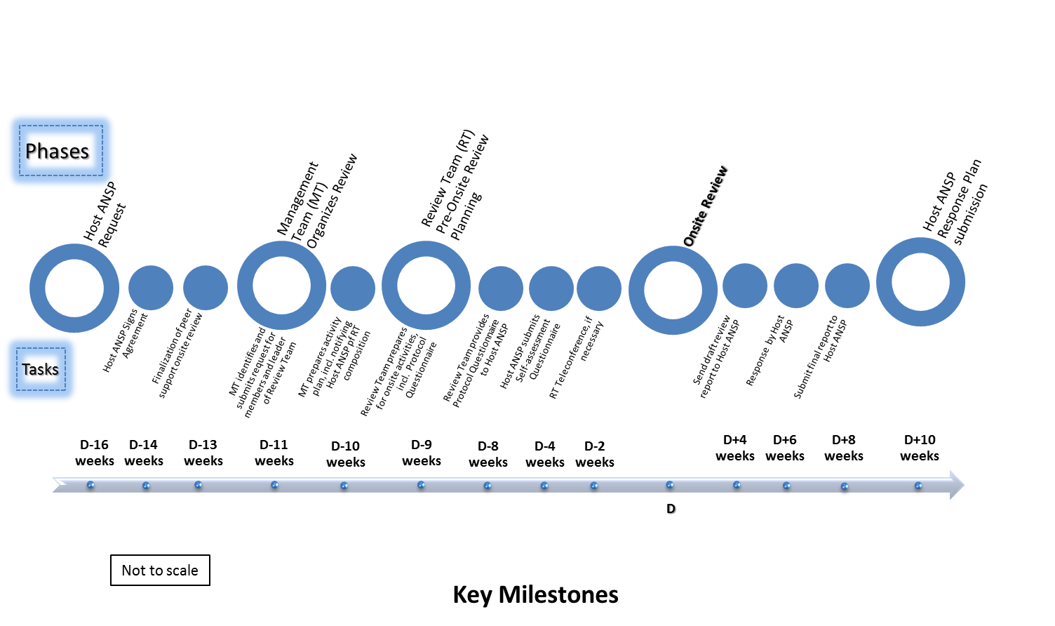

Slide 43
Enclosed:
Appendix A – Terms of Reference
Appendix B – Onsite activity timelines
Appendix C – Sample Memorandum of Understanding
Appendix D – Guidance for Host ANSP on developing Response / Corrective Action Plan (Response Plan/CAP)
Appendix E – Protocol Questionnaires

