Slide 1
ICAO AFI Plan African ANSP
Peer Review Project -
Regional Workshop
Abidjan, Côte d’Ivoire, 25-27 April 2018
Presented by: ESAF Regional Office

Slide 2

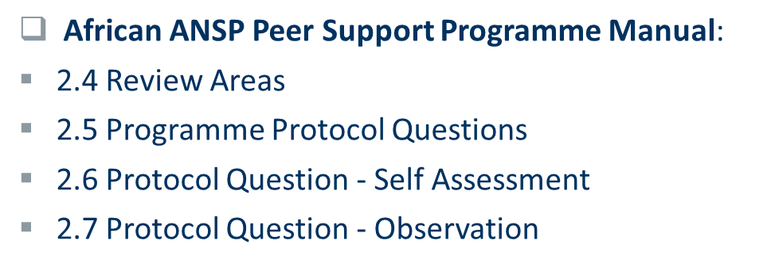

Slide 3
African ANSP Peer Support Programme Manual
  1.3. Definitions and Terminology
  Protocol Question (PQ). The primary tool used in the Programme for assessing the level of effective implementation of an ANSP’s procedures and processes.
  Protocol Question (PQ) Observation. Under the Programme, each observation is generated and expressed in terms of one Protocol Question (PQ); issuance of a PQ observation changes the status of the related PQ to not satisfactory.

Slide 4
African ANSP Peer Support Programme Manual
  2.4 Review areas
  The following review areas have been identified in the Programme:
  Air Traffic Services
  Flight procedures design
  Aeronautical Information Services
  Meteorological Service
  Communications, Navigation, Surveillance (CNS)
  Search and Rescue
  Safety Management System

Slide 5
African ANSP Peer Support Programme Manual
  2.5 Programme Protocol Questions
  Protocol Questions (PQs) are the primary tool for assessing the level of effective implementation of an ANSP’s procedures and processes.
  The PQs are based on ANS-related ICAO SARPs, PANS, ICAO documents and other guidance materials.
  They are organized by review areas.
  The use of standardized PQs ensures transparency, quality, consistency, reliability and fairness in the conduct and implementation of the Programme activities.

Slide 6
African ANSP Peer Support Programme Manual
  2.5 Programme Protocol Questions
  Each PQ is sufficiently flexible to allow the appropriate evaluation of the scope and complexity of the aviation activity in each ANSP.
  The Management Team (MT) amends and updates PQs on a periodic basis to reflect the latest changes in ANS-related ICAO provisions and Annexes to the Convention, to include emerging issues in civil aviation and to harmonize and improve PQ references and content.

Slide 7
African ANSP Peer Support Programme Manual
  2.6 Protocol Questions – Self Assessment
  Prior to a site visit, the Host ANSP is to perform a self-assessment and submit the status of PQs.
  As a priority, the Host ANSP shall conduct self-assessment:
  on PQs that were deemed not satisfactory in a previous Programme activity, if applicable.
  on new PQs introduced through PQ amendments – these PQs will have an undetermined status until they are assessed through a Programme activity.

Slide 8
African ANSP Peer Support Programme Manual
  2.6 Protocol Questions – Self Assessment
  in case of any changes in their aviation system, and/or procedures, to determine whether these changes impact the status of any PQ.

Slide 9
African ANSP Peer Support Programme Manual
  2.6 Protocol Questions – Self Assessment
  The PQ self-assessment is an important tool for ANSPs to use in order to prepare for a Programme activity.
  Each PQ includes information on ICAO references which helps identify the ICAO standard or provision related to the PQ.
  Each PQ also includes guidance for review of the PQ and examples of what the ANSP needs to establish and implement to comply with the ICAO provision outlined in the PQ. NB: This is also an indication of the type of evidence that the review team will be looking for during a Programme activity.

Slide 10
African ANSP Peer Support Programme Manual
  2.6 Protocol Questions – Self Assessment
  Regular self-assessments using the PQs is also a tool for ANSPs to actively monitor and report the health of their ANS system on a continuous basis.
  ANSPs can use PQ self-assessments to conduct scheduled internal reviews of their ANS performance.
  Thus, ANSPs can actively monitor their own systems in a proactive manner to identify and resolve safety oversight deficiencies.

Slide 11
African ANSP Peer Support Programme Manual
  2.7 Protocol Questions – Observation
  When the Review Team (RT) cannot obtain evidence indicating compliance, an observation is issued in one or more of the following cases:
  lack of implementation of ANS-related ICAO SARPs and PANS; and/or
  lack of application of guidance material and relevant ANS safety-related practices in general use to support the implementation of the ANS-related ICAO SARPs and PANS.

Slide 12
African ANSP Peer Support Programme Manual
  2.7 Protocol Questions – Observation
  Generating an observation changes the status of the associated PQ to “not satisfactory” and decreases the ANSP’s EI.
  A PQ observation is issued when there is no evidence of competency of the Host ANSP. Such evidence may be obtained during a Programme on-site activity.
  Each PQ observation must be based on one PQ.

Slide 13
African ANSP Peer Support Programme Manual
  2.7 Protocol Questions – Observation
  A PQ observation contains the not satisfactory PQ and a description of the identified deficiencies.
  In order for the MT to close a PQ observation, the Host ANSP must address the associated PQ by resolving all the deficiencies detailed in the observation.
  3.1.3. A list of PQs comprising various aspects of ANS is attached as Appendix D to the Manual.

Slide 14
African ANSP Peer Support Programme Manual
  Protocol Questions
  3.1.2. For the review proper, responses to protocol questions will serve as the primary means for the Host ANSP to provide information to the Review Team. Additional information may also be requested by the Review Team, for example queries arising from observations made during onsite visits.
  A balanced approach has been taken towards designing the review PQs, i.e., it will take into account the need to review ANS provision at both the managerial level and the operational level.

Slide 15
African ANSP Peer Support Programme Manual
  Protocol Questions – AAPSP Manual
  The ANSP PQs in this Manual are not a duplication of the USOAP CMA ANS PQs but designed to bring out specific elements to be assessed.
  The PQs have been categorized as follows: Co – Corporate, Pm – Process management, Op – Operations, Sf – Safety, Fl – Flight Procedure Design.
  Co – 16 PQs, Pm – 6 PQs, Op – 20 PQs, Sf – 17 PQs, FL – 15 PQs
  Total PQs: 74

Slide 16
African ANSP Peer Support Programme Manual
  Protocol Questions – USOAP CMS - ANS
  Note on the 2017 Edition of the Protocol Questions (PQs):
  Revised on the basis of the 2016 edition, this 2017 edition of the USOAP CMA Protocol Questions (PQs) excludes aspects related specifically to the State Safety Programme (SSP).

Slide 17
African ANSP Peer Support Programme Manual
  Protocol Questions – USOAP CMS - ANS
  For the 2017 edition of the PQs, the total number of PQs is 943.
 | Area | Number of 2017 PQs
1 | LEG | 23
2 | ORG | 14
3 | PEL | 99
4 | OPS | 146
5 | AIR | 210
6 | AIG | 104
7 | ANS | 179
8 | AGA | 168
TOTAL NUMBER |  | 943

Slide 18
African ANSP Peer Support Programme Manual
  Protocol Questions – Some Examples
  Do the current funding mechanisms ensure the provision of the necessary resources for the implementation and maintenance of the Provider’s organization?
  Has the Provider established a means of measuring its service performance, in the form of key performance indicators (KPIs) or other measurable indicators?

Slide 19
African ANSP Peer Support Programme Manual
  Action required:
  Note the information provided in this presentation on the list of Protocol Questions in Appendix D to support the peer review process; and
  The need to carry out periodic review and update of the PQs with the objective of improving the overall outcome of the peer review process.

