Slide 1
EASA Technical Cooperation activities
Updated 27 September 2016
TE.GEN.00409-001

Slide 2
Contents
General information
Main projects directly managed by EASA
EASA activities in the ASIAP priority states

Slide 3




General information
Part of European Union (EU) development policy
Mainly EU funds granted by the European Commission
Partnership with authorities and Regional Safety Oversight Organisations (RSOOs)
Focus on safety, other areas implemented together with partners

Slide 4
Strategy per region
Neighbouring Countries
Support accession/integration or interoperability with EU
Asia-Pacific
Assistance to states to meet their international obligations
Support EU institutional cooperation
Africa
Assistance to states to meet their international obligations
Latin America
Assistance to states to meet their international obligations
Support EU institutional cooperation

Slide 5
Main projects directly managed by EASA
IPA 3
EaP/CA
EUROMED
[EU-China]
[Project expected]
SIASA
ATA-AC
AATIP
[Project expected]
[Project expected]
IASOM

Slide 6
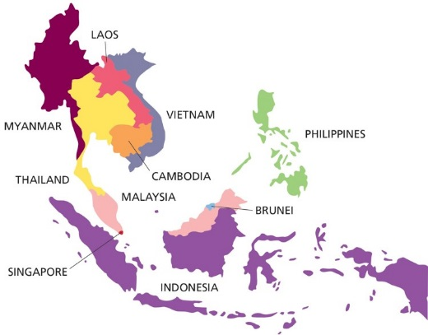
AATIP
Full Name | ASEAN Air Transport Integration Project (AATIP)
Duration | Dec 2012- Dec 2016
Beneficiaries | ASEAN states
Objective | The overall objective of AATIP is to contribute towards sustainable ASEAN (Association of South Eastern Asian Nations) economic growth and the integration of the ASEAN Economic Community (AEC), through the development of the civil air transport sector. Two main expected results of AATIP: Preparation for the ASEAN Single Aviation Market (ASAM) and its external linkages supported through the development of harmonised frameworks in aviation safety, security, air traffic management, environmental protection, market liberalisation, application of competition laws and economic regulations. Progress towards ASEAN institutional development, i.e. institutional reforms and ASEAN Air Transport Institutions’ building, and capacity of the ASEAN Secretariat and AMS authorities, operators and industry strengthened.
Other information | Project in partnership with Eurocontrol, DGAC France and UK CAA Covers also ATM, environment and economic issues.

Slide 7
ATA-AC
Full Name | Amélioration du Transport Aérien en Afrique Centrale (ATA-AC) (French title) Central Africa Aviation Safety Project (CAASP) (English title)
Duration | Aug. 2013 – Aug. 2016 (extended until 2017)
Objective | The ATA-AC project is done in the framework of the “Programme d’Appui au Commerce et à l’Intégration Economique” of the Central African States which aim is to ease their insertion into the world economy and promote the economic growth in order to reduce poverty. Within this framework, the overall objective of the ATA-AC project is to contribute to the prevention and the reduction of civil aviation incidents and accidents Three main expected results of ATA-AC are: Support the setting up of the Regional Safety Oversight Organisation ASSA-AC (Agence de Supervision de la Sécurité en Afrique Centrale) Train technical personnel from Central Africa in aviation safety Develop of action plan for the rehabilitation of the main airports in the region
Beneficiaries | Angola, Burundi, Cameroon, Central African Republic, Chad, Congo, Democratic Republic of the Congo, Equatorial Guinea, Gabon, Sao Tome & Principe

Slide 8
EaP/CA
Full Name | EASA Eastern Partnership / Central Asia project (EaP/CA)
Duration | February 2016 – February 2020
Objective | Building on the previous TRACECA project, the objective is two-fold: For countries which are part of the EU’s Eastern Partnership (EaP) to ensure their effective participation in the pan-European civil aviation system; For Central Asian countries, to support their civil aviation authorities in fulfilling their international obligations in terms of air safety and security. This is achieved through a wide scope of activities, including: Training, peer-to-peer and on-the-spot support, as well as awareness raising; Dedicated initiatives on safety management and CAA management; Effectively addressing safety findings raised by ICAO or EASA audits; Support for the implementation of existing comprehensive aviation agreements, paving the way towards a Common Aviation Area; Support for the harmonisation of regulations and working practices with international safety and security standards.
Beneficiaries | Armenia, Azerbaijan, Georgia, Kazakhstan, Kyrgyzstan, Moldova, Tajikistan, Ukraine, Uzbekistan

Slide 9
EASP (Euromed)
Full Name | Euromed Aviation Safety Project (EASP)
Duration | Jan 2015 - Dec 2016 (extended until 2017)
Objective | The overall objective of the action is to promote harmonisation of the European Neighbourhood Instrument (ENI) south countries’ civil aviation safety rules and standards with those of the European Union. The main expected results of EASP: Provide EU expertise on the practical implementation of EU civil aviation safety rules. Assist partner states towards the civil aviation safety standards of the European Union. Promote greater mutual awareness and technical contact between EASA and the partner countries. Assist in establishing technical contacts between the Mediterranean Partners themselves.
Beneficiaries | Algeria, Egypt, Israel, Jordan, Lebanon, Libya, Morocco, Palestine, Tunisia

Slide 10
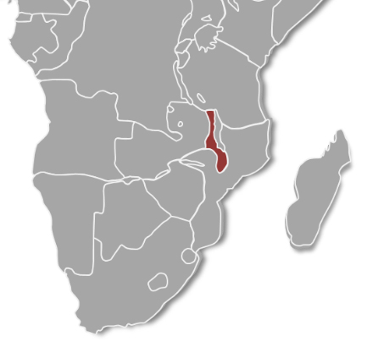
IASOM (Malawi)
Full Name | Improvement of Safety Oversight in Malawi (IASOM)
Duration | January 2014 - December 2016
Objective | The overall objective of the project is to contribute to a reliable, safe aviation environment capable of promoting economic growth in Malawi. EASA therefore focuses its primary actions towards two main specific project objectives: Contribute to the enhancement of the regulatory and institutional framework of the Malawi aviation sector Contribute to the Technical and organisational capacity building of the DCA Malawi, as well as other aviation stakeholders where found beneficial in ensuring effective implementation of the actions/activities.
Beneficiary | Malawi

Slide 11
IPA 3
Full Name | EASA Programme on aviation safety - IPA 3
Duration | July 2015 – July 2017
Objective | The overall objective of this project is to further support the beneficiary countries to fulfil their international obligations on aviation safety and to foster deeper the knowledge of the specificities of the EU’s aviation safety system stemming from the ECAA and the working arrangements with EASA. The project also aims to ensure that the beneficiary countries with the potential risk of significant aviation safety concerns will increase their capacity to close their findings. The expected results are: Where deemed necessary, the functional structure and core processes as well as relevant documentation of the administrations concerned are updated to ensure the effective transposition and implementation of the EU aviation legislation in the domain of aviation safety in accordance with the ECAA, and follow up procedures to maintain functional compliance are established; Sustainable progress is made in the fulfilment of authority oversight requirements in the domains of Airworthiness, Air Crew, Air operations,, Aerodromes, and its Management System; Corrective Action plans following up the findings identified by the Universal Safety Oversight Audit Programmes of ICAO (USOAP) or the EASA Standardisation visits, are addressing the finding and are timely developed; Training and workshops delivered in areas on commonly identified needs; Exchange of experience between/amongst beneficiaries via peer to peer support to enable better understanding on implementation models in regards to NAA’s management system and overall implementation aspects of implementing rules.
Beneficiaries | Albania, Bosnia and Herzegovina, Kosovo*, the former Yugoslav Republic of Macedonia, Montenegro, Serbia, Turkey (*This designation is without prejudice to positions on status, and is in line with UNSC 1244 and the ICJ Opinion on the Kosovo Declaration of Independence)

Slide 12
SIASA
Full Name | Support to the Improvement of Aviation Safety in Africa (SIASA)
Duration | Jan 2013 – Jan 2016 (extended to Oct 2016)
Objective | The objective of this project is as follows: Support to regional regulatory convergence and standardisation in line with international civil aviation Standards and Recommended Practices (SARPs); Support the air transport sector integration at regional level through institutional assistance and capacity building actions The assistance in the civil aviation sector provided by EASA in Sub-Saharan Africa will seek to contribute to regulatory harmonisation, policy reform and capacity building at the continental and regional level to support a safe and sustainable air transport environment and assist in gradually harmonising their regional/national systems.
Beneficiaries | Signatory countries of the Cotonou Agreement

Slide 13
EASA activities in the ASIAP priority states
Belarus – Implemented training on SMS and regulator’s audit techniques
Egypt – Beneficiary of the EUROMED Aviation Safety Project
Gabon – Assistance on AGA under the SIASA project, plus participation to training activities under SIASA and ATA-AC
Tanzania – Participation to training/workshop activities organised under the SIASA project
Guyana – Support in the field of HR for strengthening the CAA
Bahamas – No activity undertaken

Slide 14
More information: http://www.easa.europa.eu/easa-and-you/international-cooperation/technical-cooperation-projects

