Slide 1
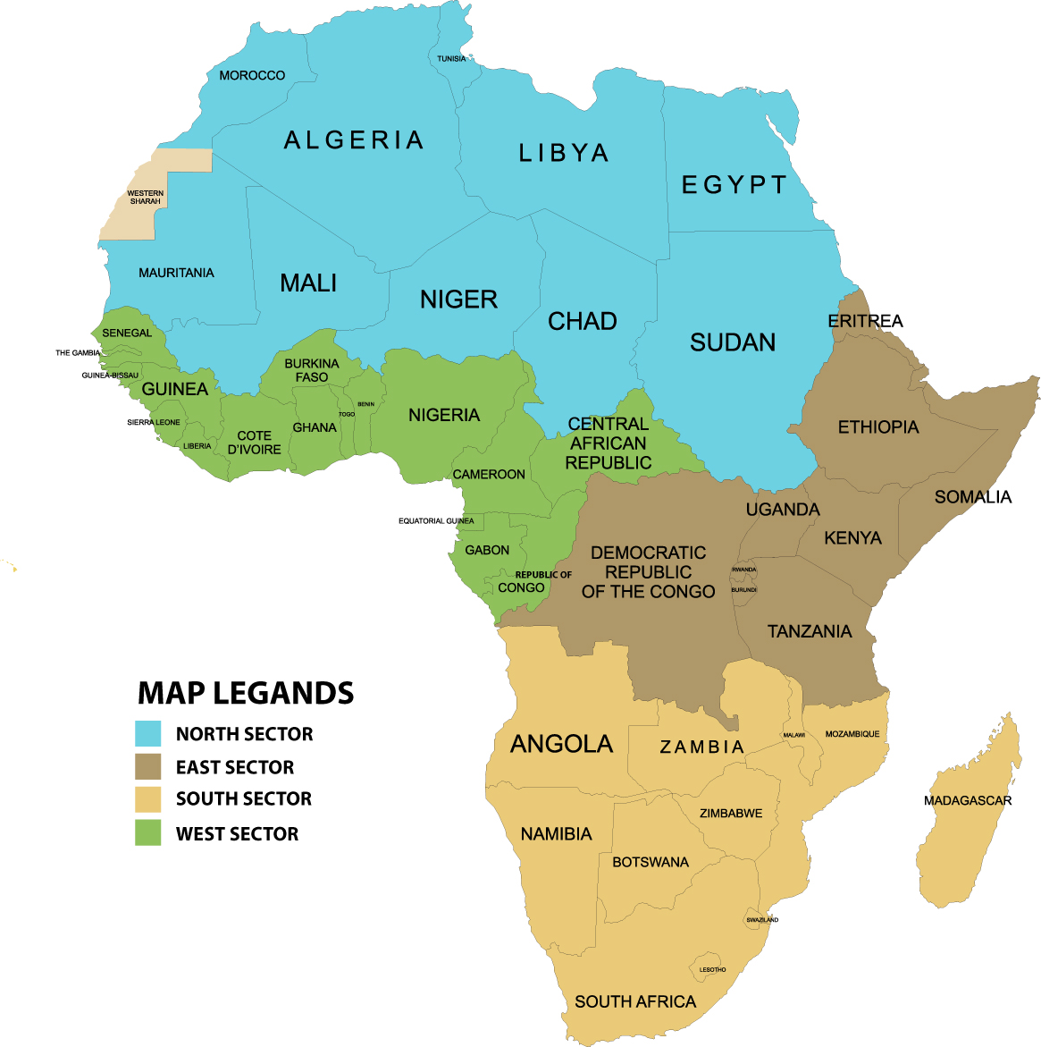
African Aviation Training Organization
Proposal Plan 2011
Developed by
TEWG – Group One.

Slide 2
DEVELOPMENT OF THE FRAMEWORK FOR THE CREATION OF THE
“ASSOCIATION OF AFRICAN AVIATION TRAINING ORGANIZATION” (AATO)
Developed by
TEWG – Group One.
Presented by
Dr.Karim A. Elsayed
Dean of CAMTC - EAA

Slide 3
Introduction
The forth Meeting of TEWG held in Nairobi on the 7 – 8 December 2010 and developed its work programme for the implementation of recommendations of the Second Pan-African Aviation Training Coordination Conference held in Cairo on 22-24 June 2010.
It has also set up deliverables and milestone to be submitted to the current Third Pan-African Aviation Training Coordination Conference.
Finally the TEWG assigned its different tasks to four groups as Follows:

Slide 4
TEWG GROUPS TASKS
Group 1: Development of the framework for the creation of the Association of Aviation Training Organization
Group 2:Development of the framework for the Establishment Centers of Excellence
Group 3: Development of the framework for the creation of the Training Advisory Board
Group 4: Development of a framework for standardization of training programme, instructor qualifications, and approval of aviation training organizations, and publish report on the status of aviation training needs and resources.

Slide 5
GROUP ONE TASK
FRAMEWORK FOR THE CREATION OF THE ASSOCIATION OF AFRICAN TRAINING ORGANIZATION (AATO)

Slide 6
The Proposal Concept
This proposal is based on the emerging trend of the African aviation academies and training centers to establish AATO as a continental body that has four Regional Aviation Training Boards and works in close cooperation with ICAO
The Main Purpose
The purpose of the AATO is the development procedures and criteria for designation of centers of excellence and activities required for aviation training centers, schools for an effective harmonization of training requirements and rationalization of the training resources in Africa

Slide 7
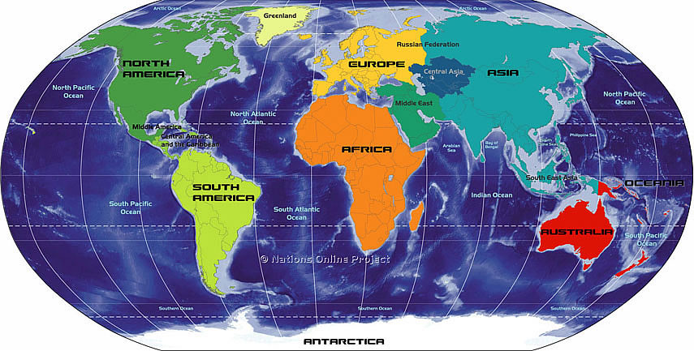
AATO

Slide 8
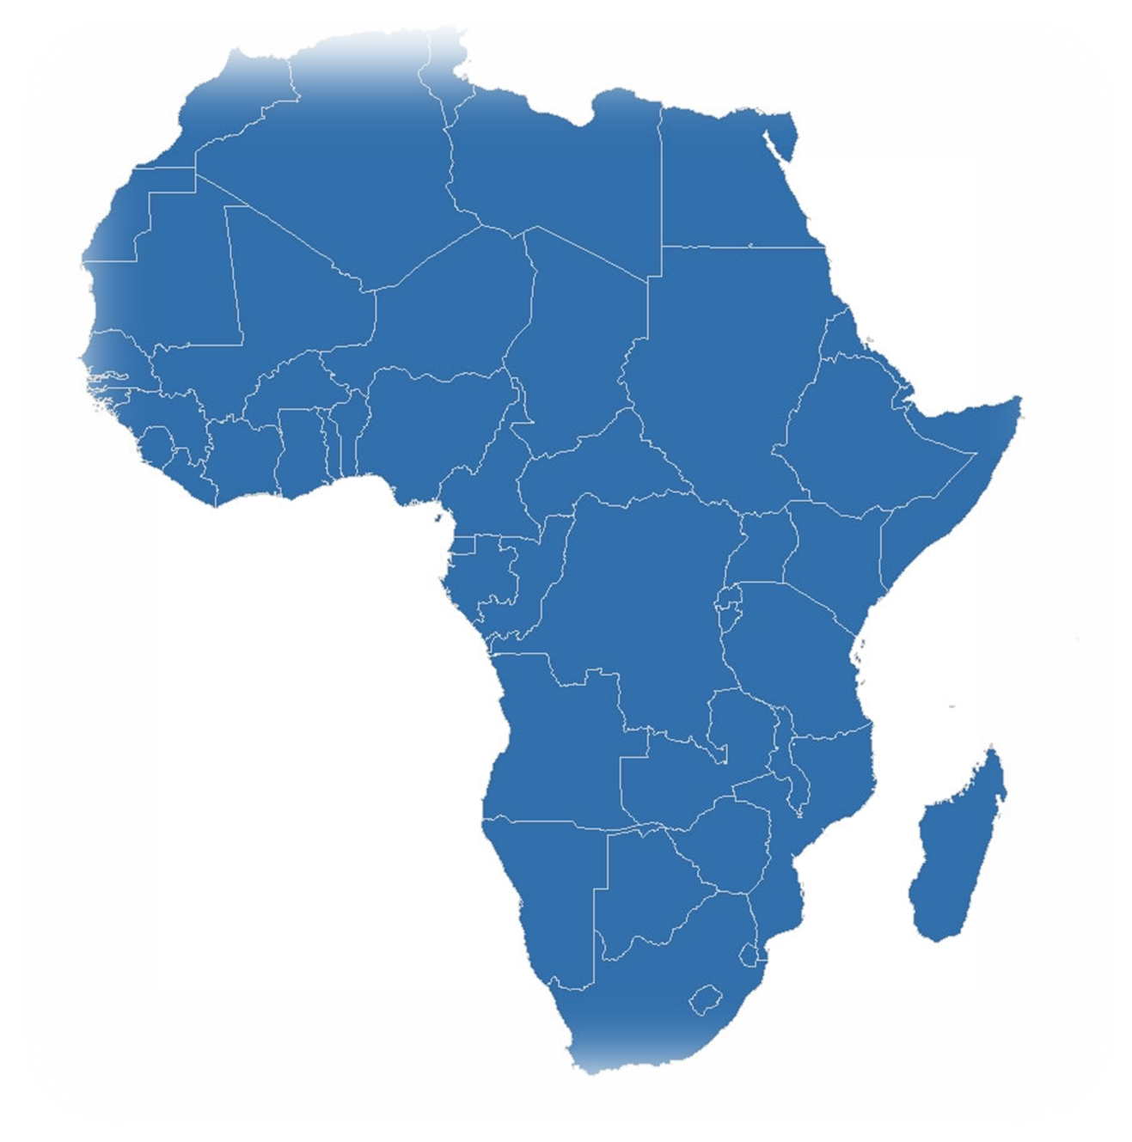
AATO STRUCTURE METHODOLOGY
The structure of AATO has been developed within a methodology that enables all aviation training academies schools and centres to reach the level of standardization leading to harmonization among the aviation training organization all over the continent

Slide 10
AATO REGIONS
Northern
Southern
Western
Eastern

Slide 11
The African continent includes four regions:
Northern, Southern , Eastern , and Western regions
Each region will have its Regional Director elected by the regional Board for three years .
The Regional Director shall be nominated by a Center Of excellence or an Academic Center which has ICAO Recognition.
The Regional Directors will be representing the four regions in the AATO council.
The AATO council will be chaired by Chief Executive through rotation among the four regions for three years.
The framework in the four regions will follow the same strategy, within a flexibility that allows every region to reach its goals and objectives by an effective way according to the conditions and the strategic plan of the region.

Slide 12
Levels of membership…
The structure of the AATO has been identified in a flexible method that enable the members to achieve the short term, as well as, the long term objectives of the AATO and to include all the aviation training centers in the continent.

Slide 13
AATO CLASSIFICATION CRITERIA
Africa shall be divided into four regions, and every aviation training center in the regional shall be classified into categories according to the Following elements:
1- The structure and training facilities of the center (buildings, laboratories, classrooms, simulators, training aircraft …..)
2- Staff capabilities (number of instructors, technical, IT operators, the level and type of qualifications, specialists in different fields.…)
3- Implementation of the ICAO Regulations.
Elements of categorization
The structure and facilities
Staff capabilities
Implementation of the ICAO Regulations

Slide 14
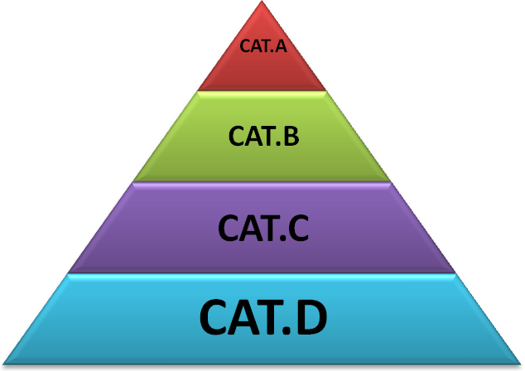
Categories of Training Centers In order to be an AATO member , your Training Center should be classified as a category A,B or C.
 | Centers that have structure - training facilities , the appropriate staff capabilities, applying the ICAO regulations.
 |  | Centers that have achieved only two of the three Above elements
 |  |  | Centers that have achieved only one of the three Above elements
 |  |  | Centers that have non of the above elements.

Slide 15
THE REGIONAL STRUCTURE.
REGIONAL DIRECTOR
REGIONAL
BOARD
VOTING MEMBERS
Category A,B & C.
Non Voting
MEMBERS
SECRETARY.

Slide 16

REGIONAL DIRECTOR (RD) …
The Regional Director shall be elected through a voting process of the regional Board which includes representatives of the Training Centers in the area of responsibility for Three years.

Slide 17
RESPONSIBILITIES 0F THE REGIONAL DIRECTOR
Managing the work in the Area of responsibility and allocating the objectives for each department.
Construct the regional plan in order to achieve the objectives specified by the AATO council and ensure that those strategies are efficient and effective.
Evaluate the implementation of the plan and provide Recommendations solving any difficulties facing the region to reach the goals.
Over view the progress of the work in the region.

Slide 18
THE REGIONAL BOARD…
The regional Board membership consists of centers of Excellency in the area of responsibility and the centers that have obtained the accreditation from the ICAO, or in the future, from the AATO Council.
Generates the regional plan, the objectives and the general policy and Framework for the regional.
Supervises the work progress in the regional, and the level of implementation.
Ensure that the training centers are working according to the regional plan and Achieving the objectives of this plan.
Distribute missions and Frame Work to ensure that each Training Center is achieving its mission appropriately and successfully.
Report to the regional Director concerning the performance and the progress of the work in the regional.
Help all Aviation Training Centers / Schools willing to upgrade its Classification in the Area of Responsibility and issuing Recommendations for a technical support .

Slide 19
REGIONAL VOTING MEMBERS.
The regional Voting membership includes every training center, academy and/or aviation school in the regional classified as a category A,B or C. and the centers that have obtained the accreditation from the ICAO.

Slide 20
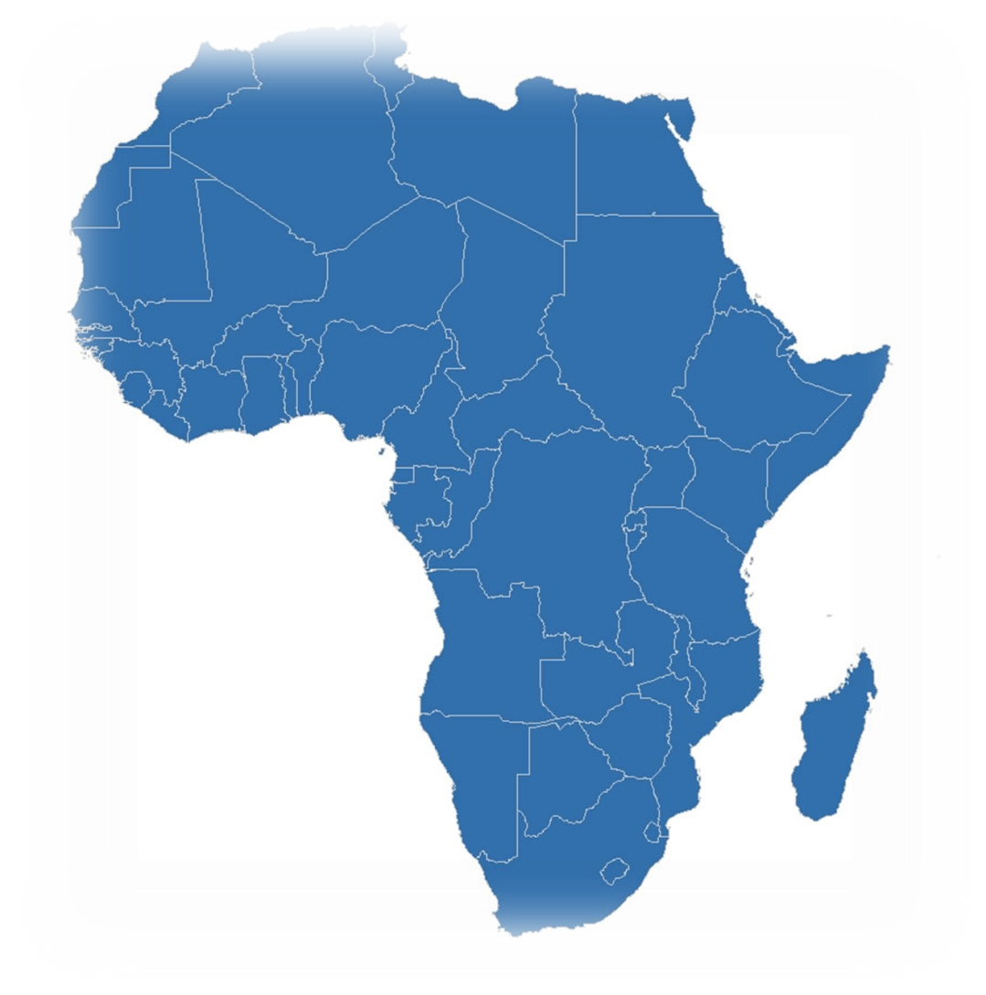
REGIONAL NON VOTING MEMBERS…
The Non Voting members do not have the Right to Vote.
The Non Voting members includes every training center in the continent that wishes to join the Organization and has the will to work on in order to achieve the objectives of the foundation of the AATO.
The Non Voting members includes every training center, academy and/or aviation school in the region that wishes to join the Organization to achieve the objectives and willing to be Classified.

Slide 21
Regional Periodic Reviews…
A review of the Region plan and its continuing adequacy will be undertaken by the Region Board periodically, but at least annual, evaluation of the performance and the extent to which the Boards has met the requirements of its Plan. Any proposed amendment to Plan will be submitted to the AATO Council for approval.

Slide 22
AATO ADMINISTRATION
The AATO Council will consist of seven members.
Four Regional Directors plus ICAO, TAB and AFCAC Representatives.

Slide 23
Aato CHIEF EXECUTIVE
AFRICAN Advisory Board representative
Secretary
AATO CONCIL
INFORMATION Technology
ICAO
representative
Tewg OFFICE.
AFCAC
representative
Northern
Regional Director
Western
Regional Director
Eastern
Regional Director
Southern
Regional Director

Slide 24
AATO MISSION…
The mission of the AATO is to construct a common strategic framework and action plan to improve the availability of affordable and quality training programs, harmonized, and standardized throughout Africa with a common African aviation training accreditation system recognized around the world.

Slide 25

 | AATO VISION
Regions drives all African civil aviation training centers to reach the level of standardization that leads to the harmonization between all of them across the continent.

Slide 26
AATO
VALUES
Excellence
Teamwork
Innovation
Flexibility
Research Orientation
Safety

Slide 27
AATO OBJECTIVES…
Unit the Training Centers under the Umbrella of One Organization.
Develop a standard criteria for the approval of aviation training Centers to reach the Center of Excellency.
Develop common standards for aviation training Programs to be implemented throughout all aviation training centers in Africa.
Facilitate the use of accredited training centers in Africa by multiple states contributing to the rationalization and harmonization of the training resources.
Establish a framework of cooperation and co-ordination between the Organization and the international civil aviation organizations
Evaluate the level of performance of all training centers in Africa establish and provide solutions in order to help them to reach the Goal.

Slide 28
Responsibilities of the AATO Council
The Council shall be association. responsible for the business of the AATO, shall make and enforce necessary rules for its management, and shall present at each annual meeting a complete statement of the financial condition of the

Slide 29
THE AATO COUNCIL…
The AATO council membership consists of the regional Directors of the Four regions of the continent and which are elected every Three years by the regional's Board Plus a representative of the African Advisory Board and the ICAO Representative.
The AATO Council generates the strategic planning For The Continental, Also the objectives and the general policy of the Organization.
Supervises the work progress in the Organization, and the level of implementation of the defined strategic plan, in each regional.

Slide 30
THE AATO COUNCIL…
3 - The AATO Council will annually confirm the membership of the Regional's Board.
4. Responsible for selecting the members of the TEWG office in coordination with the regional Board .
5 . Issuing approvals for the new members of the regional once they have achieved the requirements for upgrading their Categories
6 - Responsible for the co-ordination process between the AATO and the international organizations such as the ICAO, AFCAC… etc. Through the Chief Executive who Represents Africa.
30

Slide 31
THE AATO COUNCIL CONTINUE…
7. Assuring safety and operating regulations are clearly specified and applied in the regions.
8. Harmonize and Standardize the training programs and Evaluate the implementation of the Strategic Plan .
9. Endorsement will be granted only after an assessment conducted by
TEWG ,indicates that training programs, facilities and instructors Qualification according ICAO Requirements
10. the AATO Council will provide advice, guidance and experts to any region to solve any Problem Facing the regional Board to facilitate their duties.

Slide 32
AATO TEWG Office…
Duties
Assisting the AATO Council in managing the performance of the regional's and Provide solution Concerning the problems that may face the regional's .
Develop the strategic plan for the Continent.
Ensuring the application of the approved strategic Plan By AATO Council in the region..
Issuing recommendations for the AATO Council in order to be presented to the regional.
Assisting the regional Directors taking decisions concerning the Strategic Plan in the area of his responsibility.
Issuing continuous reports for the AATO council concerning the work progress in the region and the level of coordination between the training centers.
Researches and studies concerning the methods that can Improve Training Performance.

Slide 33
AATO TEWG STAFF…
AATO TEWG Office Continue…
8) Assessing the centers requesting upgrade and Provide the AATO Council with Recommendation to be Approved.
9) Evaluate the implementation of the Strategic Plan and Provide Recommendation for solving any difficulties Facing a regional plan.
AATO TWEG Staff
The staff of the TEWG office shall include experts in the aviation training management with sufficient experience in performing the duties of this position.
The staff shall be selected from the centers that are already categorized as CAT.- A. and/or Expert has a scientific degree in the Aviation Field.

Slide 34
AATO MEETINGS…
The AATO Council will hold at least two meetings each year in order to fulfil its duties.
The Chief Executive shall act as Chair of any meeting of the Council.
Any Meeting of the Council shall be held at a location and time set by the Chief Executive.
The purpose for the meeting will be to install the new Members , Discuss the Recommendation of the TEWG when council action is required to Solve any Problems Facing the Regions.

Slide 35
A Mid-year Meeting of the AATO Council shall be held at a location and time set by the Chief Executive. The primary purpose of this meeting will be to consider matters of policy and procedures and discuss , review reports of the Regional's Director , and to conduct other Matters Related to the Strategic plan.
Special meetings of the Council members may be called by the Chief Executive with written notice mailed to each member at least two week before the date appointed.
This notice shall state the times and locations and the
reason for calling the meeting and no business shall be transacted at the meeting except that specifically referred to in notice.

Slide 36
Notice of each regular meeting of the members or Council shall be given in the AATO newsletter, by mail, electronic transmission, or in person to each member at least thirty (30) days prior to the date of such meeting, and the notice shall state briefly the purpose of the meeting.

Slide 37
Reporting…
The AATO Council, through the Chief Executive, will provide advice and guidance to the regions and approved training Centers in the form of minutes of its meetings, supporting papers, and written reports.

Slide 38
Secretary…
The Secretary of the AATO will be responsible, in conjunction with the Chief Executive and Regional Directors, for drawing up the agenda (supported by explanatory documentation) and circulating papers to the Members prior to each meeting.
Members may request papers for, or from, any meeting and will be notified in advance of the agenda of forthcoming meetings.
The Secretary will also be responsible for keeping the minutes of the AATO Council Meetings.

Slide 39
Preparation of Minutes…
Following a meeting of the AATO Council, the Secretary will prepare a draft of the minutes of that meeting.
The minutes are the objective summary of key areas of discussion, any opposing views on an issue and key actions and recommendations.
The Secretary will circulate the draft minutes to all Members and will accommodate all return comments in the next draft of the minutes, clearly attributing content to the person who provided it.

Slide 40
Financial Management…
The AATO Council may need funding to execute and/or discharge its mandate. To achieve this purpose, the Council may establish a Finance Office.
The AATO Council has to have ICAO funding in place, Disbursement should be in line with the approved African Strategic Plan budget.
The Regional Board may get funding from a variety of sources, including but not limited contribution by the region, approved aviation training Centers.
The Regional Board has to get budget on an annual basis.

Slide 41

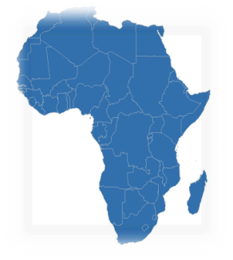
Thank You

