Slide 1

African Aviation Training Organization
Proposal Plan 2011
Developed by
TEWG – Group One.

Slide 2
GROUP ONE TASK
FRAMEWORK FOR THE CREATION OF THE ASSOCIATION OF AFRICAN TRAINING ASOCIATION (AATA)
2

Slide 3
DEVELOPMENT OF THE FRAMEWORK FOR THE CREATION OF THE
“ASSOCIATION OF AFRICAN AVIATION TRAININGASSOCIATION” (AATA)
3r-PAN - African
Group One.
Presented by
Dr.Karim A. Elsayed
Dean of CAMTC - EAA

Slide 4
Introduction
The forth Meeting of TEWG held in Nairobi on the 7 – 8 December 2010 and developed its work programme for the implementation of recommendations of the Second Pan-African Aviation Training Coordination Conference held in Cairo on 22-24 June 2010.
It has also set up deliverables and milestone to be submitted to the current Third Pan-African Aviation Training Coordination Conference.
Finally the TEWG assigned its different tasks to four groups as Follows:

Slide 5
TEWG GROUPS TASKS
Group 1: Development of the framework for the creation of the Association of Aviation Training Organization
Group 2:Development of the framework for the Establishment Centers of Excellence
Group 3: Development of the framework for the creation of the Training Advisory Board
Group 4: Development of a framework for standardization of training programme, instructor qualifications, and approval of aviation training organizations, and publish report on the status of aviation training needs and resources.

Slide 6
The Proposal Concept
This proposal is based on the emerging trend of the African aviation academies and training centers to establish AATO as a continental body that has four Regional Aviation Training Boards and works in close cooperation with ICAO
The Main Purpose
The purpose of the AATA is to bring together the African aviation training organizations on the continental level to address the issues of common interest on the objectives of reaching the standardization and harmonization and common level of accreditation of aviation training in Africa.

Slide 7
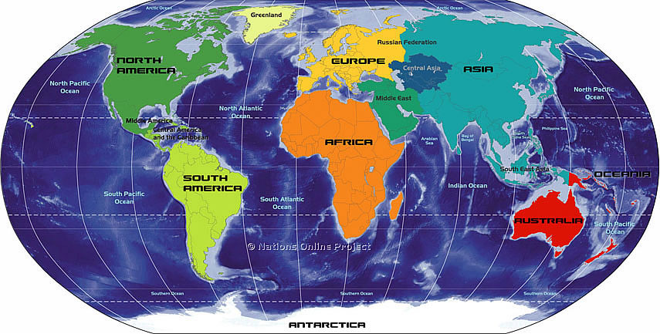
AATO

Slide 8

AATO STRUCTURE METHODOLOGY
The structure of AATO has been developed within a methodology that enables all aviation training academies schools and centres to reach the level of standardization leading to harmonization among the aviation training organization all over the continent

Slide 10
AATO REGIONS
Northern
Southern
Western
Eastern

Slide 11
AATA Organization
The structure of the AATA has been proposed in a flexible method that enables the members to achieve the short, medium and long term objectives of the AATA and to include all the aviation training centers in the continent.

Slide 12
AATA Organization
AATA ASSEMBLY
AATA Council
COE
Scretariat
12

Slide 13
AATA Organization
- The AATA Assembly : All the AATA members
- The AATA Council : Regions representatives
ICAO Representative
AFCAC Representative
TAB Representative
The TEWG Office
- The AATA General Secretary :
COE and Secretary Officials
13

Slide 14
AATA Organization
Each region will have its representative(s) in AATA council who will be nominated and elected by the members of AATA Assembly belonging to that region.
The representatives of the four regions of the continent are members of the AATA council.
The AATA council will be chaired through the rotation among the representatives of the four regions through election by the Assembly for three years
14

Slide 15
AATA Organization
The COE of the association will be appointed by the AATA Council for 5 years. The COE will have the right to re-apply for the position at the end of his term.
The details of the duties , structure, and capabilities of the AATO Bodies , including the Assembly , the council and COE, will be set out in accordance with the AATA Constitution .
15

Slide 16
AATA Membership
AATA membership will be open for all African Aviation Training Academies , centres and schools in addition to the organizations that are supporting AATA in any way . The membership has three levels or types as follows :
Active or Full Member
Associate Member
Corporate or Allied Member
16

Slide 17
AATA Membership
AATA Active Member ( Full Member )
African Aviation Training Academies , centres and schools ( ATOs ) that have completed its structure . staff capabilities and compliant with ICAO regulations in the area of activity .
This completion will be indicated by the approval and accreditation by the respective CAA.
Those ATOs shall apply to the AATO for full membership submitting the necessary documents and requirements . The Application for such membership will be submitted to the AATA Secretariat , studied by the Council and submitted to the Assembly for acceptance . The membership start fee will be paid by the applicant then the annual fee will be paid to AATA .
17

Slide 18
AATA Membership
AATA Associate Member
African Aviation Training Academies , centres and schools ( ATOs ) that are on their to completed its structure . staff capabilities and /or compliance with ICAO regulations in the area of activity and accordingly still working to be approved and accredited by the respective CAA. Those ATOs shall apply to the AATO for associate membership submitting the necessary documents and requirements . The Application for such membership will be submitted to the AATA Secretariat , studied by the Council and submitted to the Assembly for Acceptance . The membership start fee will be paid by the applicant then the annual fee will be paid to AATA . The associate member can ask for the technical support , consultation and recommendations from AATA Bodies provided that it will pay the cost of the services provided to it by any of AATA bodies .
18

Slide 19
AATA Membership
- AATA Corporate Member
The African national and regional aviation organizations that are interested in participation in the AATA activities can be accepted as a corporate or allied member . Other industry companies and aviation facilities manufacturers , if applied for the membership , can also be accepted as corporate or allied` member .
The Application for such membership will be submitted to the AATA Secretariat , studied by the Council and submitted to the Assembly for acceptance . The membership start fee will be paid by the applicant then the annual fee will be paid to AATA
In all cases those organizations and companies can be invited to participate in AATA meetings as observers .
19

Slide 20
AATA Meetings
The AATO Council will hold two meetings each year April and October) in order to fulfill its duties. However, extraordinary meeting can convened to address urgent issues and to prepare for the extraordinary meetings of the Assembly. The meeting of the Council shall be held at a location and date set by the Council
The assembly will convene once annually (July). And extra ordinary meeting of the assembly can be held upon the request of the majority of the AATA members or by the request of the council if deemed necessary.
The meetings of the TEWG office will be determined in close coordination between the COE and the Chairperson of the council .
The COE will work as the secretary general of all the meetings of the AATO .
20

Slide 21
Financial Management
Initial funding is needed for the establishment phase of the association. Coordination should be effected with ICAO to supply the needed funds and financial management of the association in the first phase until the AATO established.
The funds needed to perform the activities of the association will depend on the following funding sources:
Start membership fee as well as the annual fee to be paid by the members.
Annual support allocated to the association by ICAO, and other organizations.
Gifts and soft loans submitted by donor states and organizations.
The secretariat will prepare a financial estimation for the funds needed for establishment phase as well as the annual funds needed for the association to perform its annual activities. This estimation will be an indicator to decide the amount of funds needs for the transition phase as well as the start fee and annual fee to be paid by each member.
21

Slide 22
Recommendations
The conference is invited to adopt the general framework and outline of the AATO
Te Secretariat is kindly invited to finalize the documentation harmonizing the constitutions of AATA according to the Framework adopted and send the finalized documents to the members end of August 2011 for final comments
End of September the Secretariat will initiate the invitation of the constitutive assembly that is proposed to be held in January 2012
22

Slide 23


Thank You

